Slide 1
BUILDING A STRONG FOUNDATION:
How GSA Structure Affects Transparency, Representation, and Participation
CALIFORNIA WATER LAW SYMPOSIUM, PANEL 6 FEBRUARY 2, 2019
Moderator:
Panelists:
Nell Green Nylen Wheeler Water Institute, Center for Law, Energy & the Environment (CLEE) at Berkeley Law
Paul Gosselin Butte County Department of Water and Resource Conservation
Nicole Kuenzi State Water Resources Control Board
Adriana Renteria Community Water Center

Slide 2
INTRODUCTION

Slide 3
Milestones for local implementers under SGMA:
FORM GSA(S)
ADOPT PLAN(S)
IMPLEMENT PLAN(S)
ACHIEVE SUSTAINABILITY
by June 30, 2017
by Jan. 31, 2020
or Jan. 31, 2022
by Jan. 31, 2040
or Jan. 31, 2042
Critically overdrafted basin
Other medium- or high-priority basin
TODAY

Slide 4
SGMA provides a lot of flexibility:
Many potential governance options, e.g.,
DWR, GSP Emergency Regulations Guide (2016) (Figure 5)
For regulating extraction
For increasing supply
Many potential management options, e.g.,
Well spacing requirements
Reasonable well operating regulations to minimize interference
Requiring metering
Charging pumping fees
Establishing pumping allocations
Authorizing transfers of allocations
Providing substitute water supplies
Recharging groundwater
Providing incentives for recharge
Notes:
Some strategies related to different aspects of direct oversight over surface water diversions.

Slide 5
Criteria for evaluating the efficacy and fairness of local governance options:
Focus on three criteria related to fairness:
Transparency
Representation
Participation
Kiparsky et al., Designing Effective Groundwater Sustainability Agencies: Criteria for Evaluation of Local Governance Options (2016) (Figure 1)

Slide 6
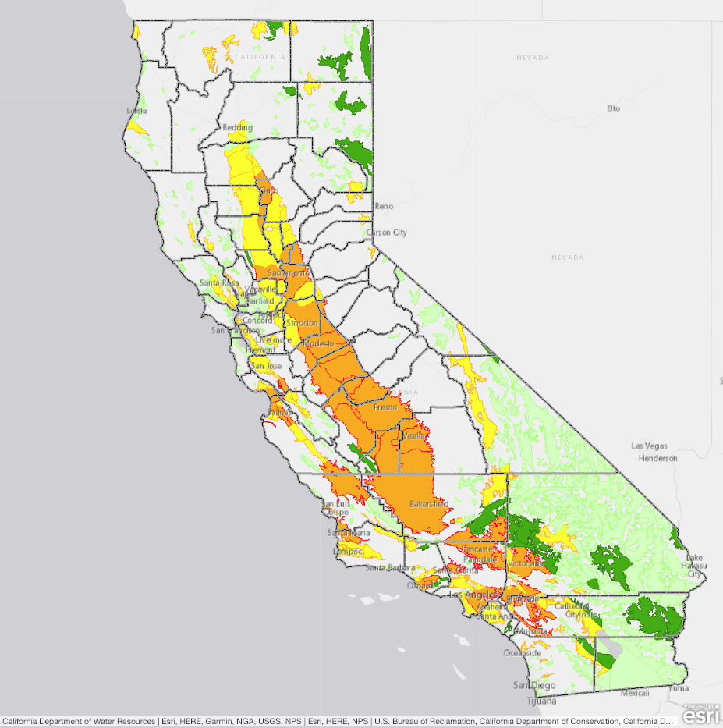
Panel perspectives:
GSAs
Basin stakeholders
State oversight agencies
Paul
Adriana
Nicole

Slide 7
DISCUSSION

Slide 8
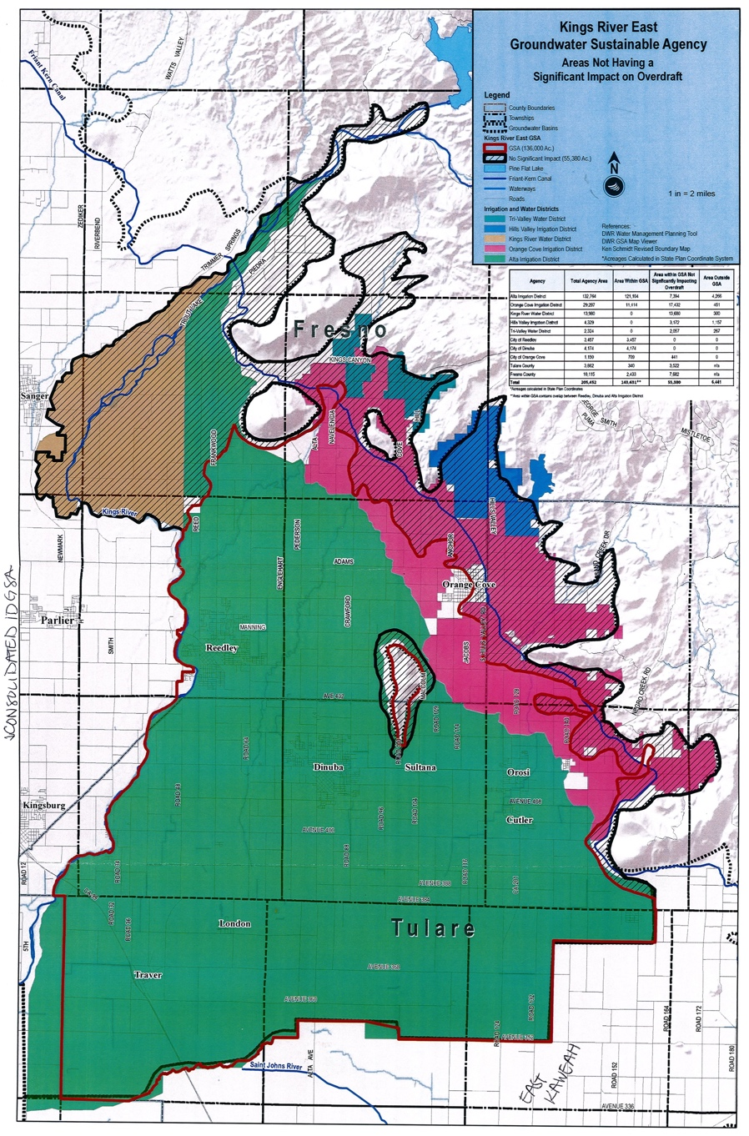
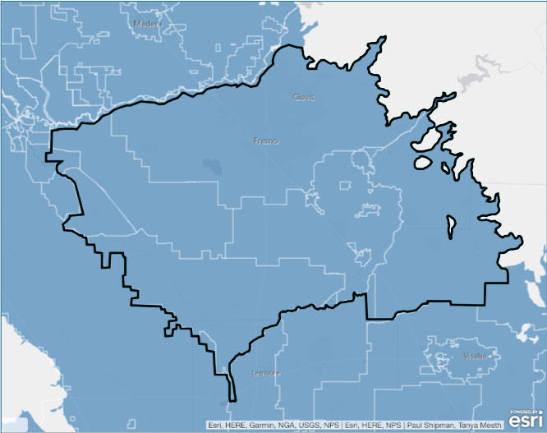
Kings Subbasin
San Joaquin Valley Basin
Kings River East GSA
Notes:
III. ADRIANA

Slide 9
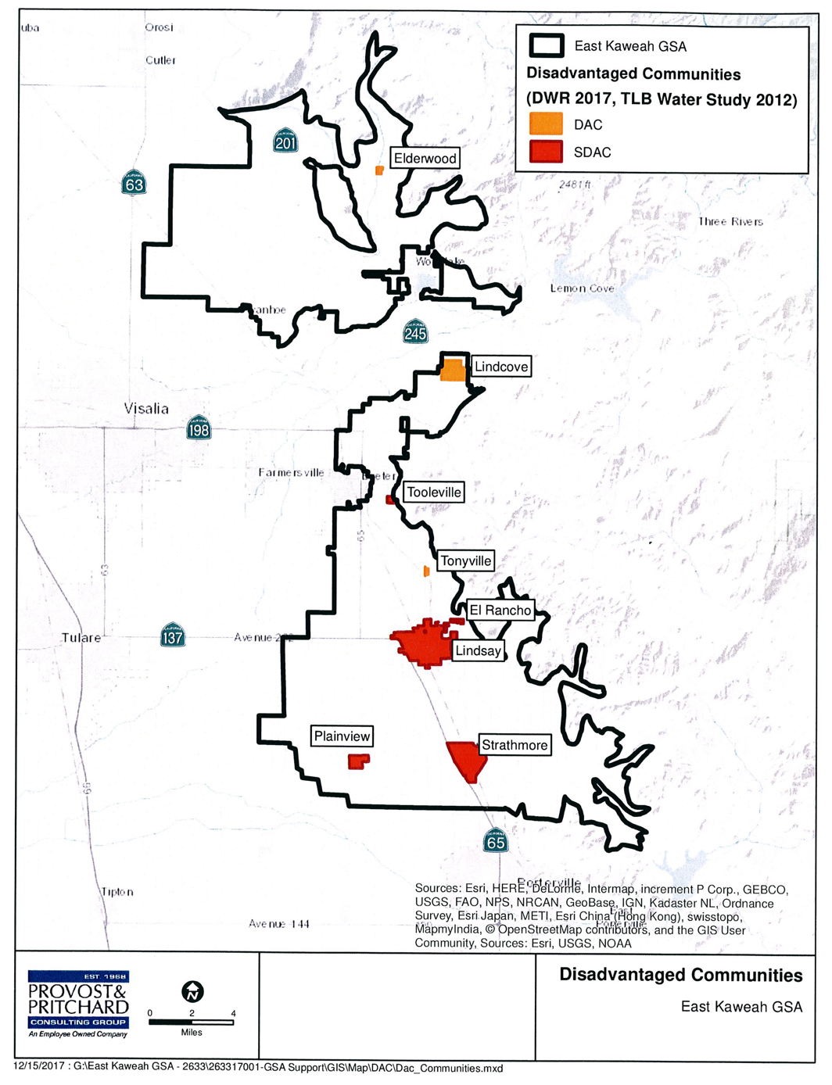
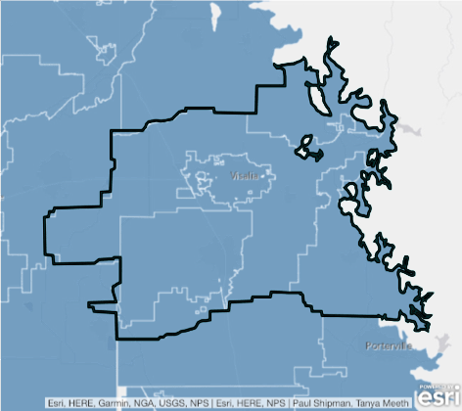
Kaweah Subbasin
San Joaquin Valley Basin
East Kaweah GSA
Notes:
III. ADRIANA

Slide 10
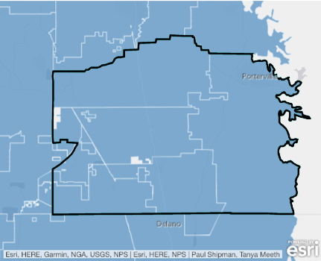
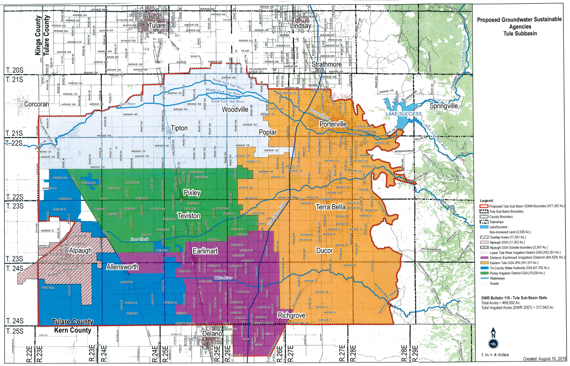
Tule Subbasin
San Joaquin Valley Basin
GSAs in Tule Subbasin
Notes:
III. ADRIANA

Slide 11
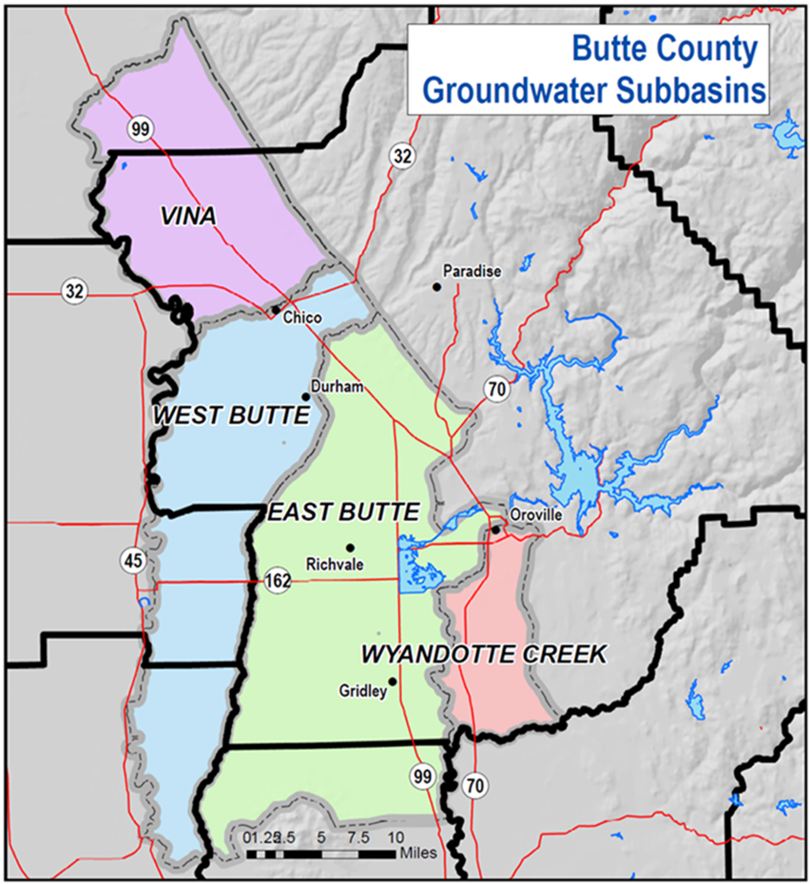
Sacramento Valley Subbasins in Butte County

Slide 12
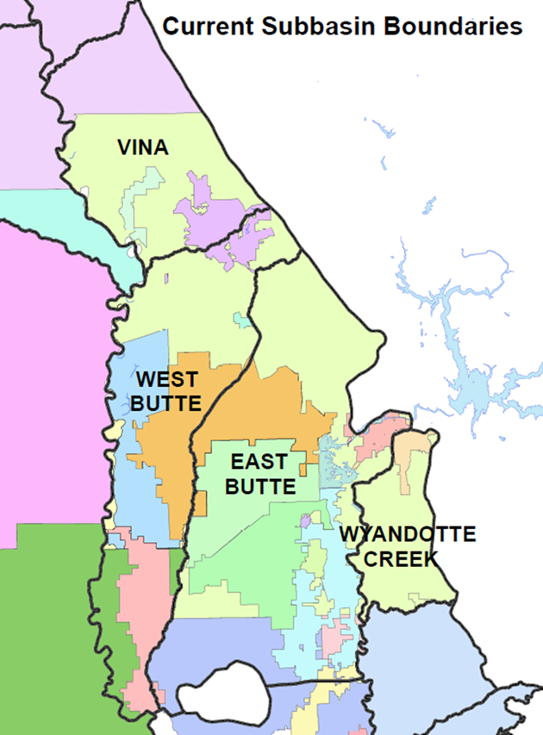
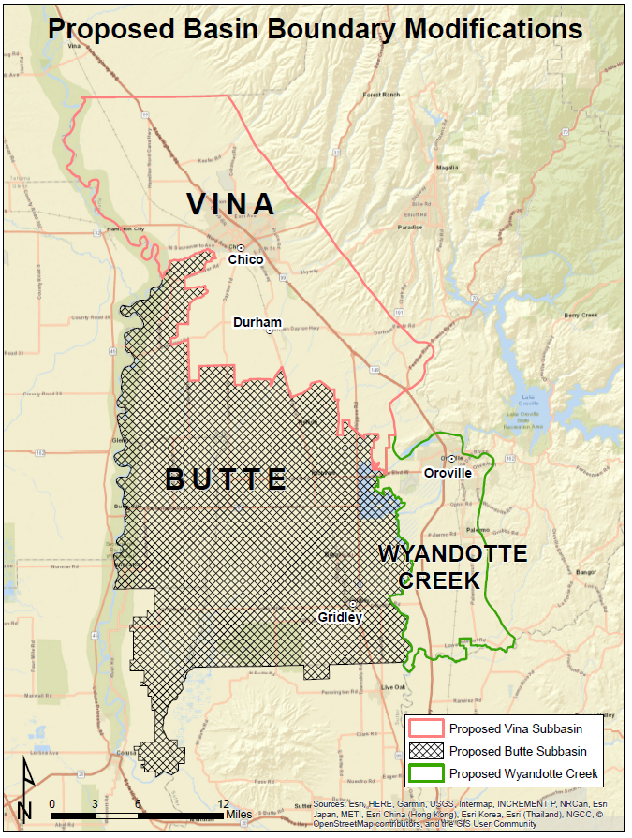
GSAs in Butte County Subbasins and proposed basin boundary modifications

Slide 13
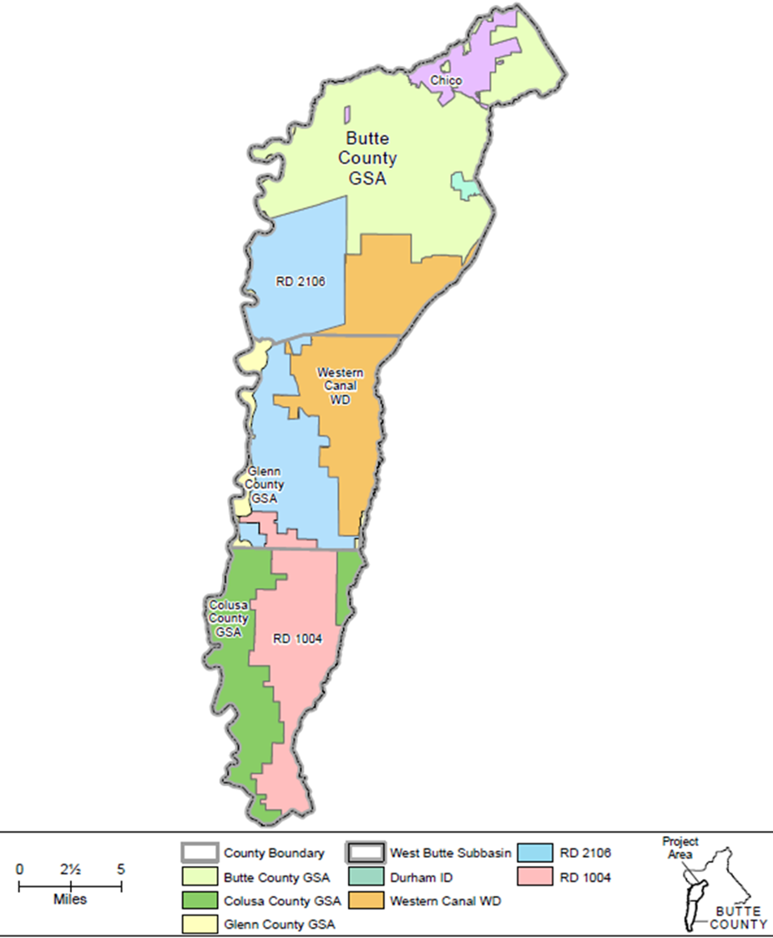
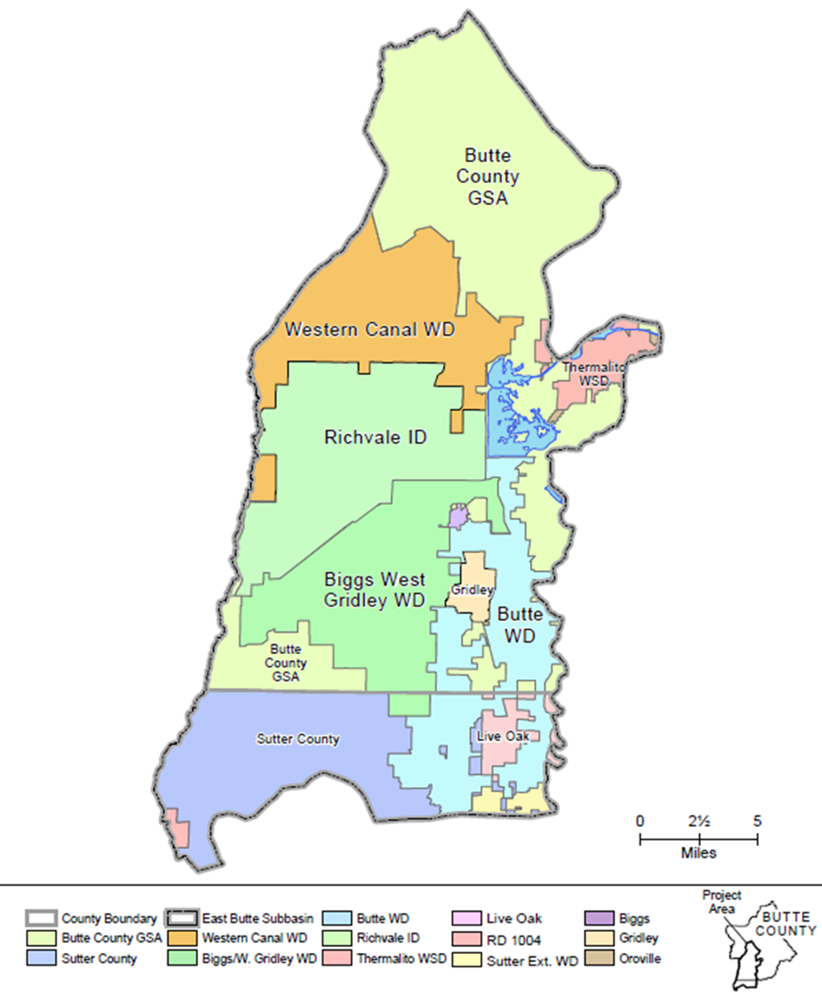
West Butte Subbasin
East Butte Subbasin

Slide 14
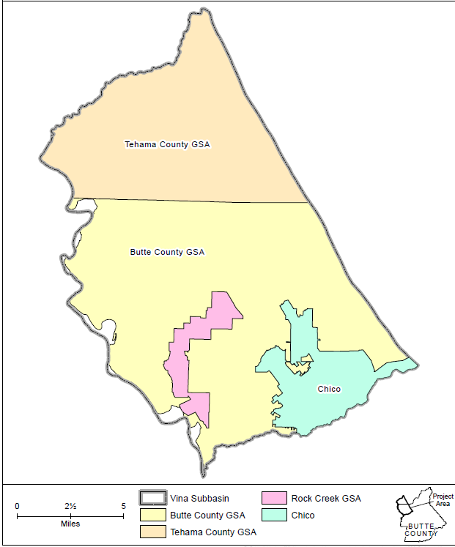
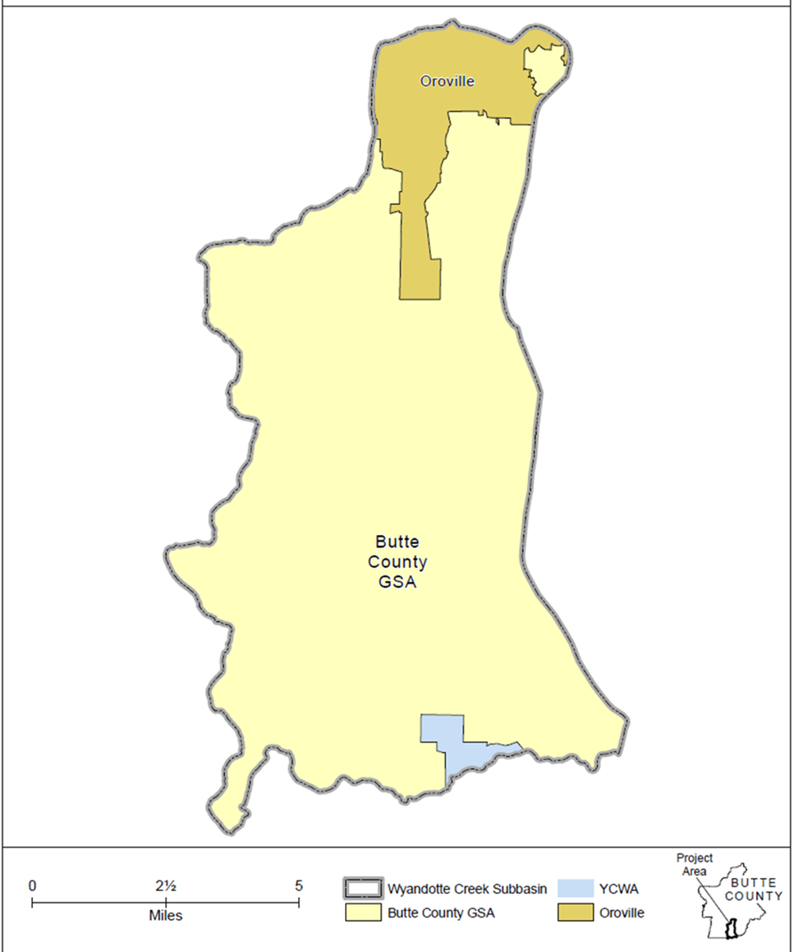
Vina Subbasin
Wyandotte Creek Subbasin

Slide 15
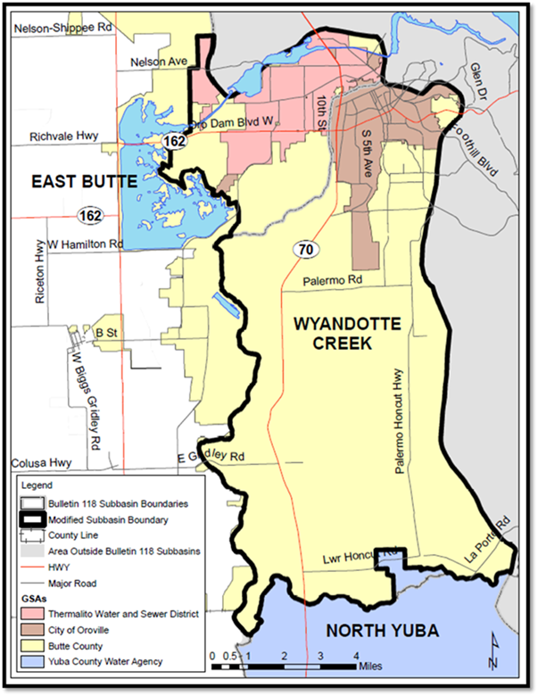
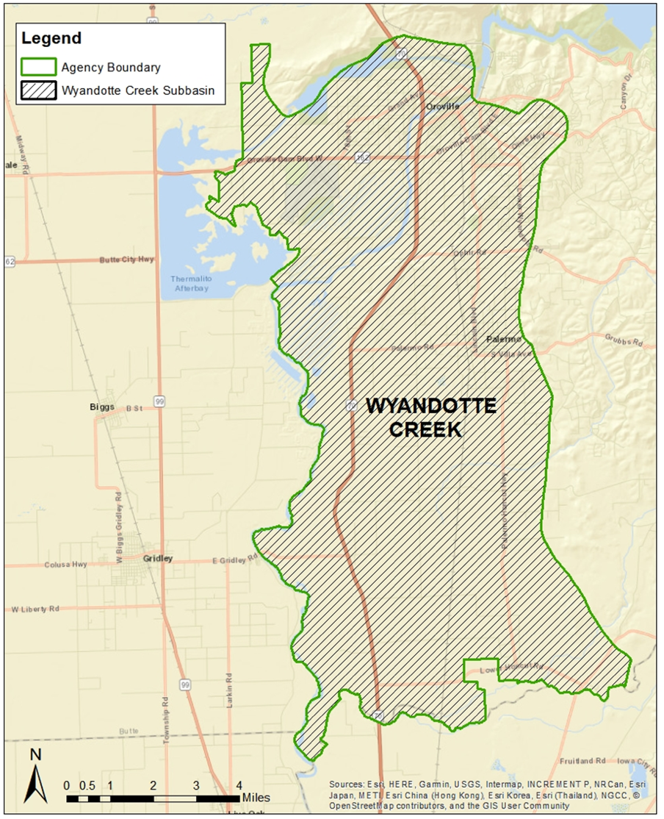
Wyandotte Creek Joint Powers Agreement

Slide 16
SGMA provisions related to transparency:
Requirement | Water Code §
Before becoming a GSA, a local agency must provide public notice, hold a public hearing, and submit complete notification to DWR, and DWR must post the notification on its web site. | 10723(b), 10723.8(a),(b)
A GSA must keep a list, available upon request, of those interested in receiving notices about GSP preparation, meeting announcements, etc. | 10723.4
A GSP must include a variety of information, e.g., information about the physical setting and characteristics of the aquifer system, measurable objectives and interim milestones for achieving sustainability, monitoring and management of basin sustainability indicators, and how applicable general (and other) plans are related to the GSP. | 10727.2
Before adopting or amending a GSP, a GSA must provide notice and hold a public hearing. | 10728.4
A GSA must submit annual reports on basin conditions to DWR. | 10728
A GSA must give notice and hold a public meeting before imposing or raising regulatory fees and must follow constitutional requirements for imposing property-related fees. | 10730(b),(c) 10730.2(c)

Slide 17
SGMA provisions related to participation:
Requirement | Water Code §
Before deciding to form a GSA, a local agency must hold a public hearing in each county overlying the basin. | 10723(b)
A GSA must “consider the interests of all beneficial uses and users of groundwater.” | 10723.2
Any person can request to be placed on a GSA’s list of persons interested in receiving notices about GSP preparation, meeting announcements, and the availability of relevant documents. | 10723.4
GSAs must notify the public how interested parties can participate in GSP development and implementation. | 10727.8
A federally recognized Indian tribe can participate in the development or administration of a GSP. | 10720.3(c)
Before adopting or amending a GSP, a GSA must provide notice and hold a public hearing. | 10728.4

Slide 18
Some basins and subbasins contain many GSAs:
(As of June 30, 2017)
Conrad et al., Diverse stakeholders create collaborative, multilevel basin governance for groundwater sustainability (2018) (Figure 2)

Slide 19
AUDIENCE QUESTIONS

