Slide 1


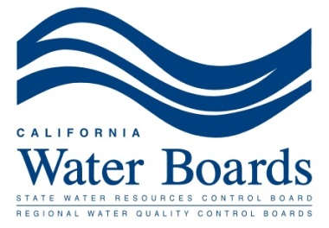

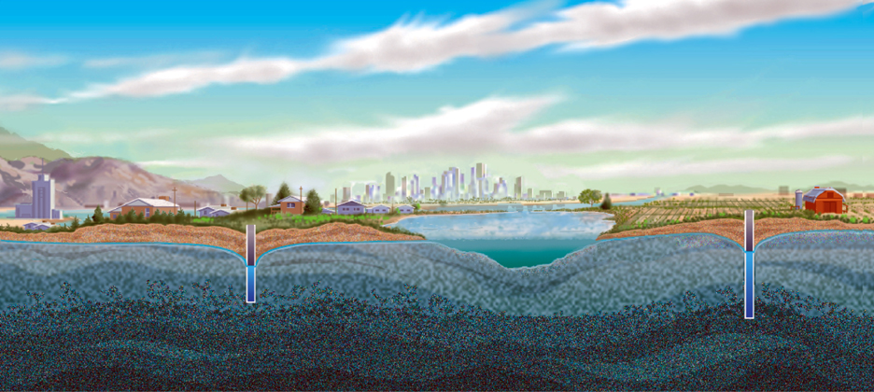
Interconnected Groundwater and Surface Water under SGMA
Kevin O’Brien Rick Frank Andy Sawyer Letty Belin Paul Kibel
Source: USGS

Slide 2
Overview
Technical concepts (O'Brien)
California water law (Frank)
SGMA's basic structure (Sawyer)
Interconnected water and undesirable results (Belin)
Interconnected water and fisheries (Kibel)
The ELF case (Frank)
Questions and Answers

Slide 3
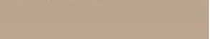
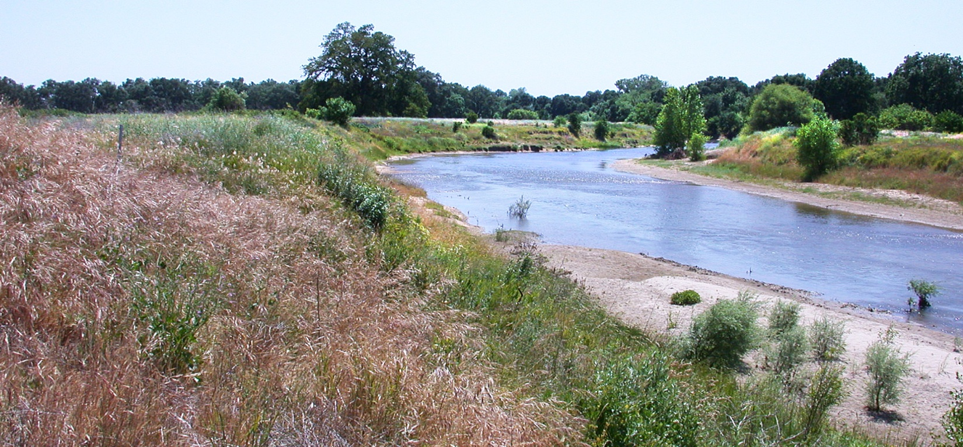
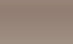
Groundwater – Surface Water Connection

Slide 4
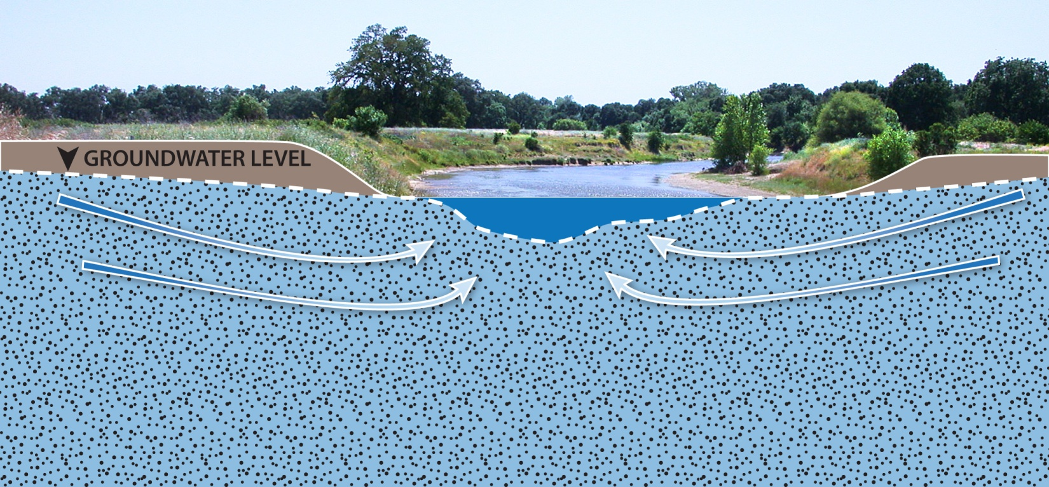
Groundwater – Surface Water Connection
“Gaining Stream”
High Groundwater Levels
Groundwater Maintains Stream Flow

Slide 5

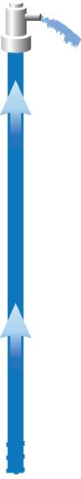
Groundwater – Surface Water Connection
“Losing Stream”
Pumping Lowers Groundwater Levels
Stream Loses Flow to Groundwater

Slide 6
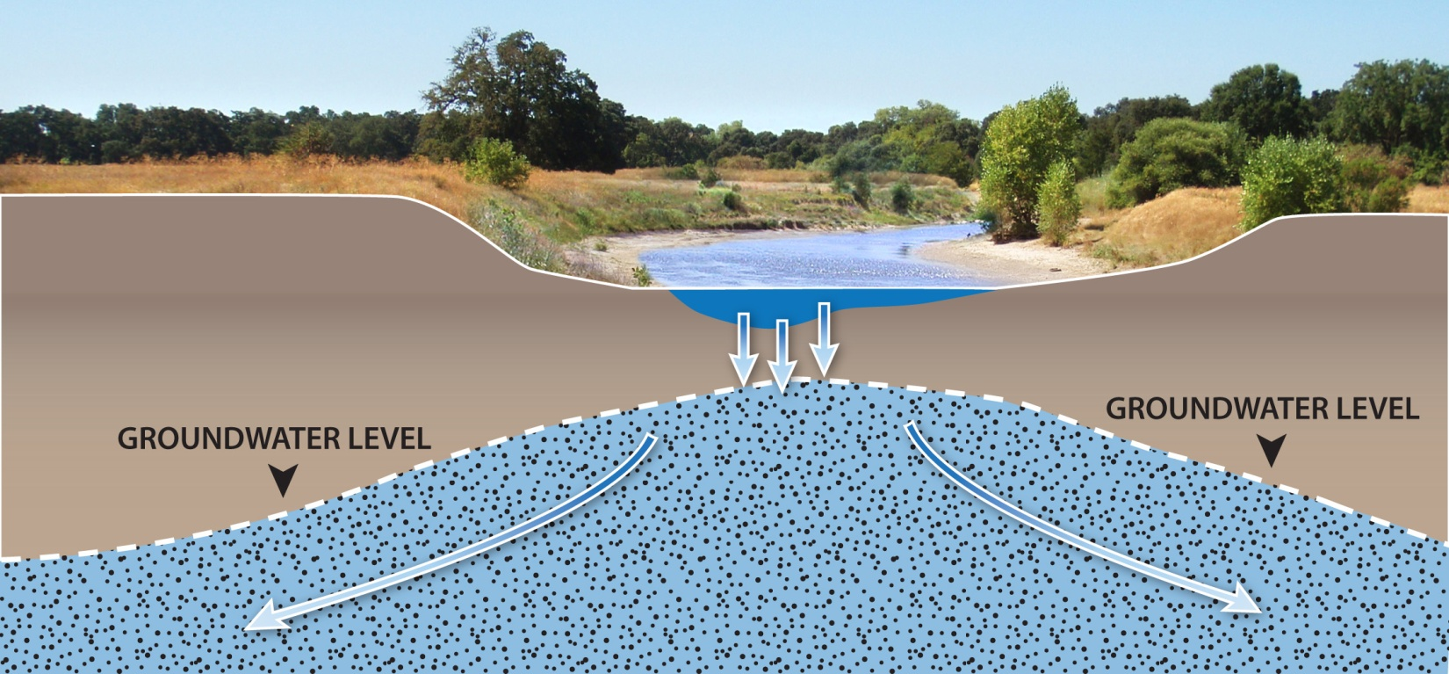
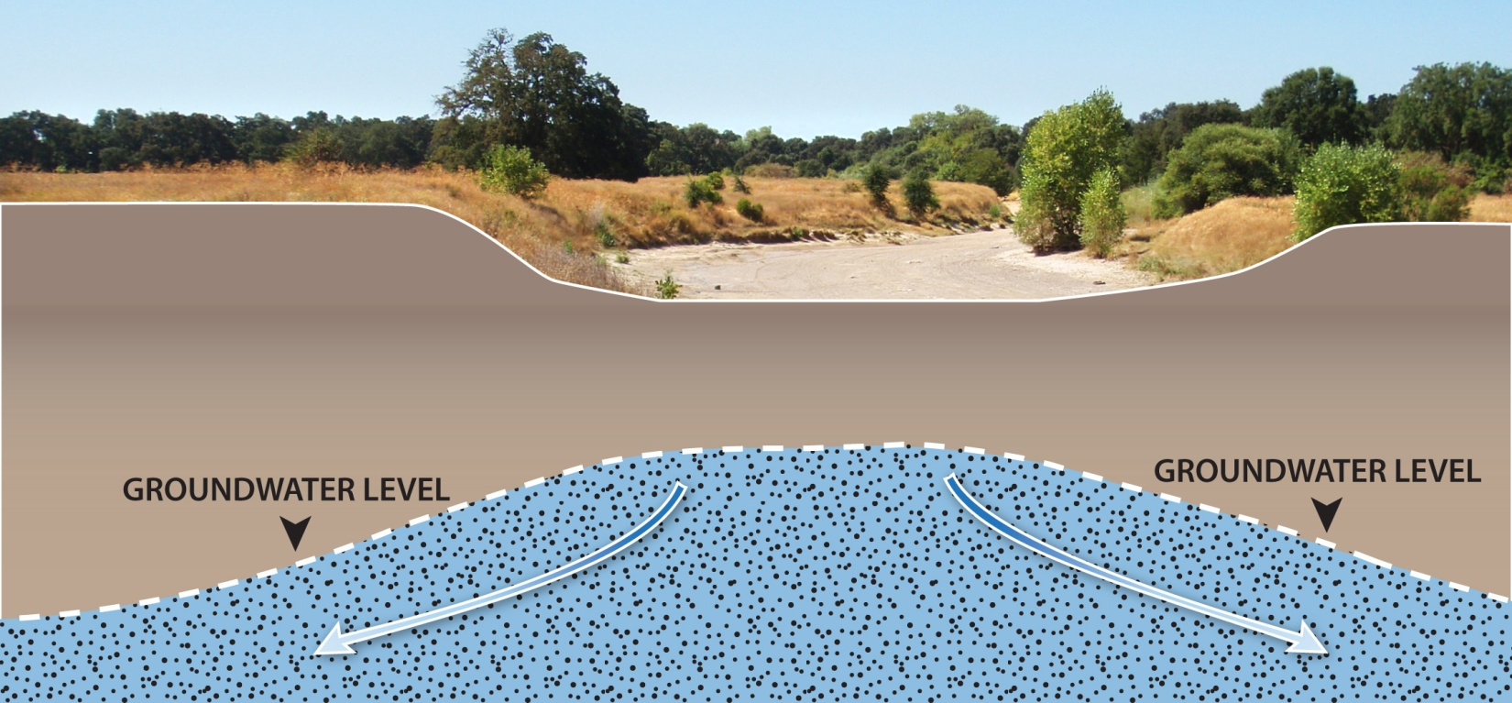
Groundwater – Surface Water Connection
“Losing Stream”
Groundwater Levels Below Stream Channel
Pumping Lowers Groundwater Levels
Stream Loses Flow to Groundwater

Slide 7
A Brief Overview of California Law of Surface Water & Groundwater Rights
Richard M. Frank
Professor of Environmental Practice
Director, California Environmental Law & Policy Center
U.C. Davis School of Law

Slide 8
INTRODUCTION
Two basic types of surface water rights:
  Riparian: based on location of land adjacent to water. Riparian systems used in England, eastern states of United States.
    These are areas with substantial precipitation.
  Appropriative: based on beneficial use. Water can be used far from the stream.
    Most common system in arid Western states.
California has both—a hybrid system, and treats groundwater separately. How did we get here?

Slide 9
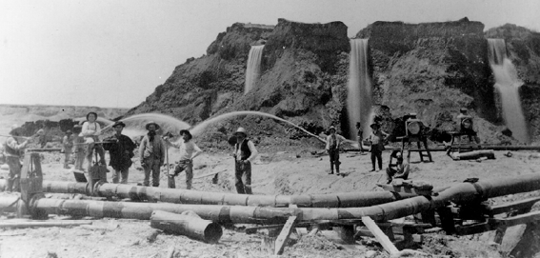
HISTORY
1855 – Irwin v. Phillips. Court recognized the appropriative system used by miners on public lands. Recognized the “political and social condition of the country”
1884 – Hydraulic mining halted. (Farmers, cities v. miners.)

Slide 10
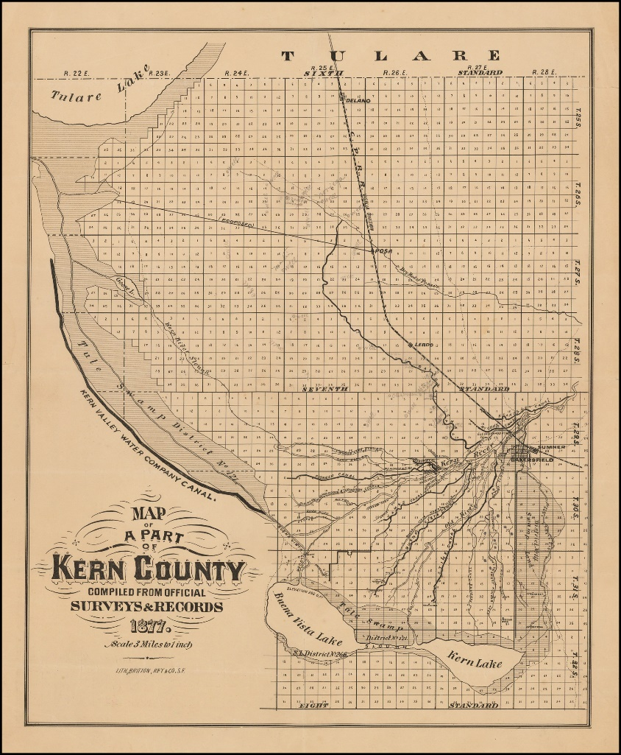
HISTORY CONT.
1886 – Lux v. Haggin. Court affirmed riparian rights on private lands. Riparian rights subject only to prior appropriations on public domain.
1914 – California Water Commission Act. Set up prospective permit system for appropriative rights in surface water.
Map of Kern County Irrigation Canals, at the time they were debated in Lux v. Haggin. Photo: BLR Antique Maps, Inc.

Slide 11
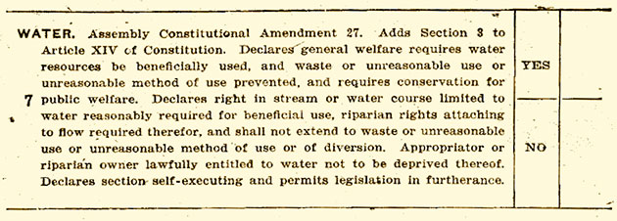
HISTORY CONT.
1928 – Voters of California approve amendment to California constitution to prohibit waste and unreasonable use of water. All water use must be reasonable and beneficial.
  Amendment refers to conditions prevailing in the state, e.g., arid climate.
  Applies to all types of water rights.
  Now codified as Article X, section 2.

Slide 12
RIPARIAN RIGHTS
Riparian rights are based on contiguity to watercourse. (“Ripa” is Latin for “bank”).
1. Riparian rights are for use on riparian property adjoining a watercourse. They attach only to the smallest parcel in the chain of title that has always been adjoining. If a large parcel is divided, any portion no longer adjacent to the stream loses riparian rights, unless deed says otherwise.
Notes:
Riparian rights.

Slide 13
RIPARIAN RIGHTS
The riparian land must be in the watershed of the stream.
Riparian rights apply only to water available under natural conditions. No “foreign” water; no seasonal storage.
Riparian rights are “correlative,” i.e., owners have equal rights among themselves and share the water in case of shortage. (Not based on time of first use.)

Slide 14
RIPARIAN RIGHTS
No permit from SWRCB is required.
Riparian rights generally have priority over appropriative rights (but not always).
Riparian use can start at any time, and still be correlative with other riparians.
Riparian rights are not lost by non-use, but unexercised riparian rights can be given lower priority by SWRCB in stream adjudications.

Slide 15
APPROPRIATIVE RIGHTS
THE THREE BASIC ELEMENTS OF APPROPRIATION:
Intent
Diversion
Beneficial Use (This is the key element.)
  Beneficial use is the source and measure of the right.
PRIORITY: First in time, first in right!

Slide 16
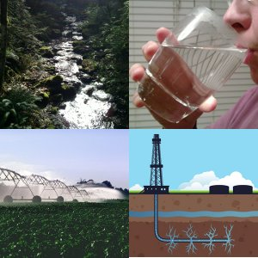
BENEFICIAL USES
Irrigation
Domestic
Municipal and Industrial (M&I)
Power
Aquaculture
Fish and Wildlife Habitat
Recreation
Fire protection, frost protection, mining, stock watering
Photo: The Water Wealth Project

Slide 17
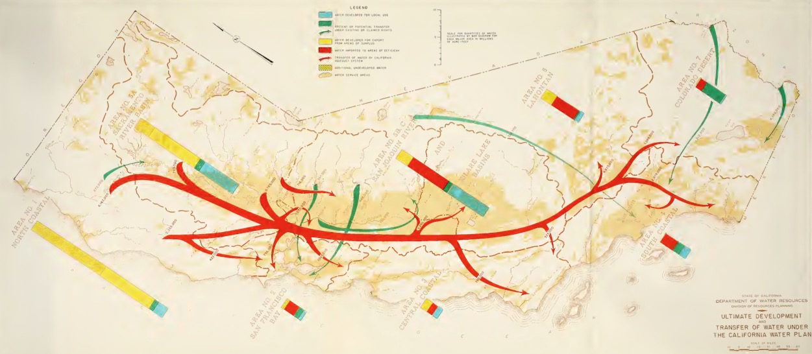
TWO TYPES OF
APPROPRIATIVE RIGHTS:
Pre-1914 appropriative: No SWRCB permit required. Based on beneficial use initiated before December, 1914.
Post-1914 appropriative: Requires SWRCB permit or license.
Early map illustrating statewide appropriations -- “Ultimate Development and Transfer of Water Under The California Water Plan”
Photo: California Department of Water Resources, 1957

Slide 18
WATER CODE
Water Code § 102: “All water within the state is the property of the people of the state, but the right to the use of water may be acquired by appropriation in the manner provided by law.”
So, the people own the water.
Water rights are Usufructuary. Right to the use of water.
Still, water rights are treated as a sort of property right.

Slide 19
GROUNDWATER LAW
IN CALIFORNIA
California law follows the legal fiction that groundwater and surface water are separate.
  Subterranean water flowing in known and definite channels is treated as surface water, and any diversion requires permit from SWRCB. (Water Code § 1200.)
  Most groundwater, known as “percolating groundwater,” does not require SWRCB permit.

Slide 20
BUT….
Hydrologists (and water lawyers) know that this fiction is not true.
Groundwater and surface water are often interconnected.
Diverting one can affect the other.
Shouldn’t they be managed together?

Slide 21
RIGHTS IN
(PERCOLATING) GROUNDWATER
Owners of land overlying a groundwater basin have “overlying” rights to pump water from the GW basin for use on overlying land.
Among overlyers, rights are “correlative” (a.k.a. the “Common Supply Doctrine”) . They share the “safe yield” of the basin. “Safe yield” is the amount that can be pumped annually without causing an undesirable effect such as declining groundwater levels or land subsidence.
If there is a surplus, it may be pumped and diverted for use away from the basin. Such use is called “appropriative.”

Slide 22
GROUNDWATER--CONT.
4. Among appropriators, first in time, first in right.
Between overlyers and appropriators, overlyers have priority.
No SWRCB permits have historically been required for pumping of “percolating groundwater.”

Slide 23
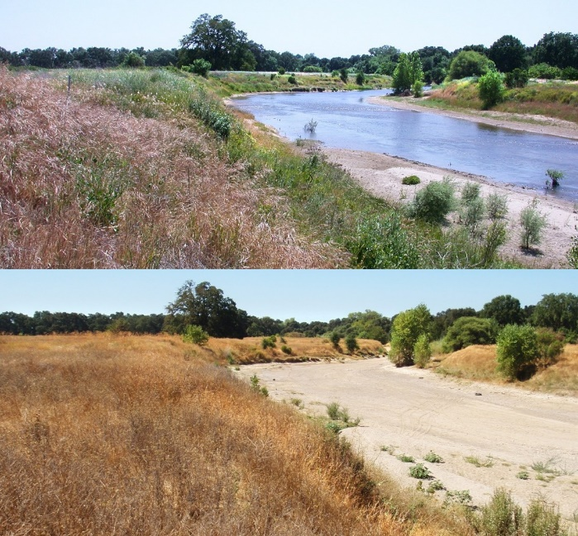
California Water Rights re: Surface & Groundwater:
How Sensible is This System?
Seasonal interaction between surface and groundwater – Cosumnes River Photo: Environmental Defense Fund

Slide 24
Groundwater Management
Source: PPIC

Slide 25
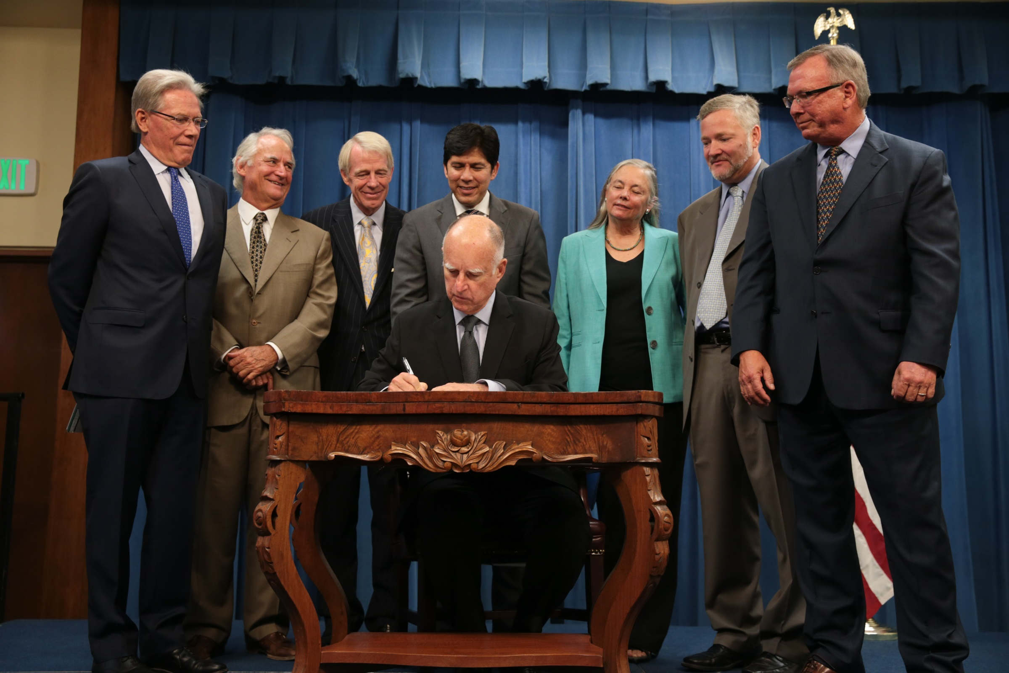

Slide 26
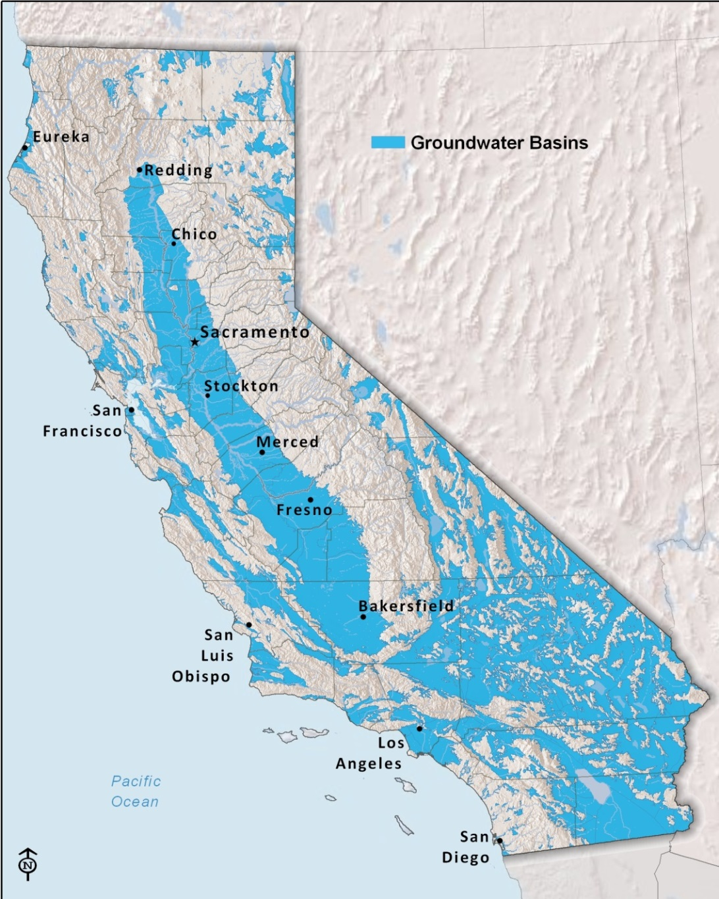
Sustainable Groundwater Management Act
Provides authority to manage a “basin.”
§ 10721
. . . .
(b) “Basin” means a groundwater basin or subbasin . . . .
. . . .
(g) “Groundwater” means water beneath the surface of the earth within the zone below the water table in which the soil is completely saturated with water, but does not include water that flows in known and definite channels.

Slide 27
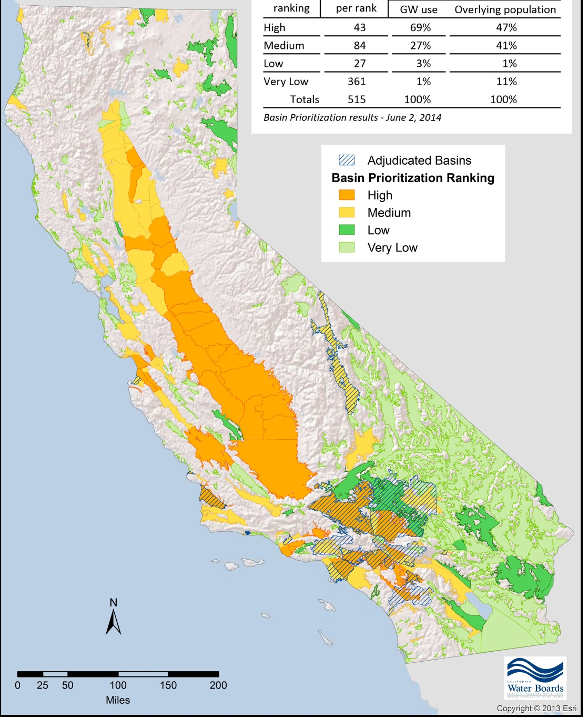
High- and Medium- Priority Basins
Notes:
Adjudicated basins are not subject to SGMA, and the area subject to a settlement between Los Angeles and Inyo County is treated as an adjudicated basin for this purpose.

Slide 28
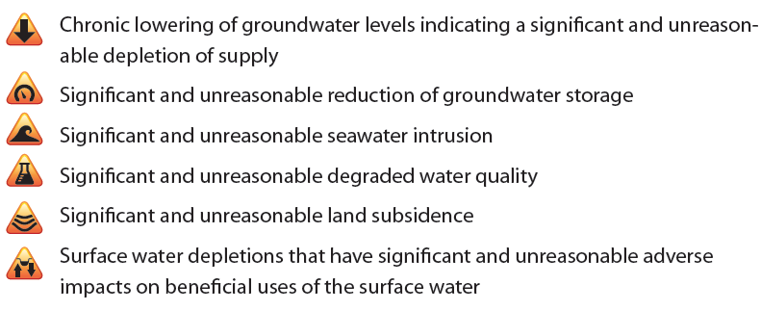
What is sustainable groundwater management?
Managing groundwater without causing:

Slide 29
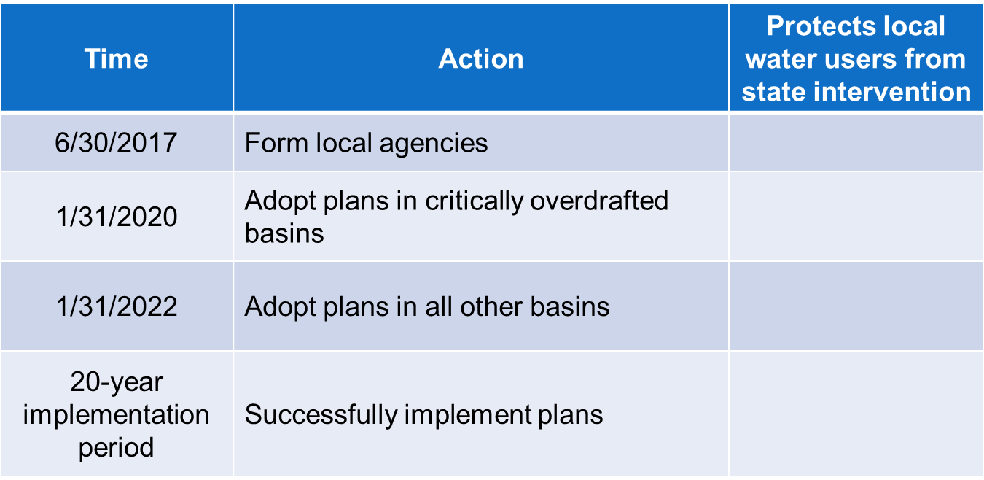
Key dates for local agencies

Slide 30

State Intervention

Slide 31
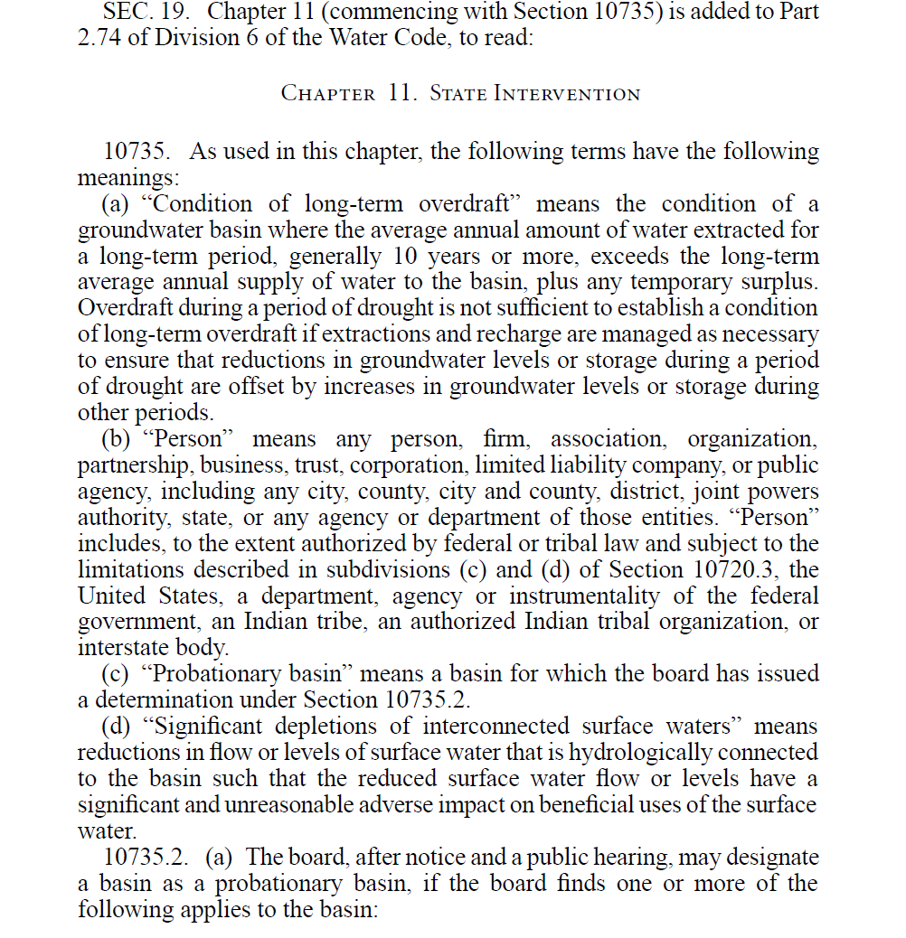

Slide 32
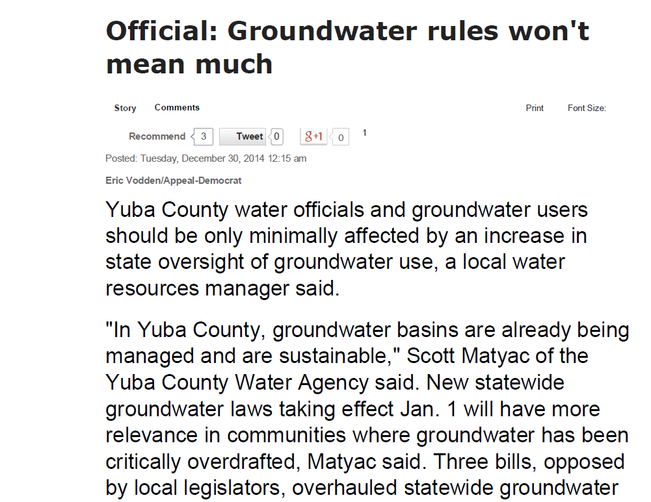

Slide 33
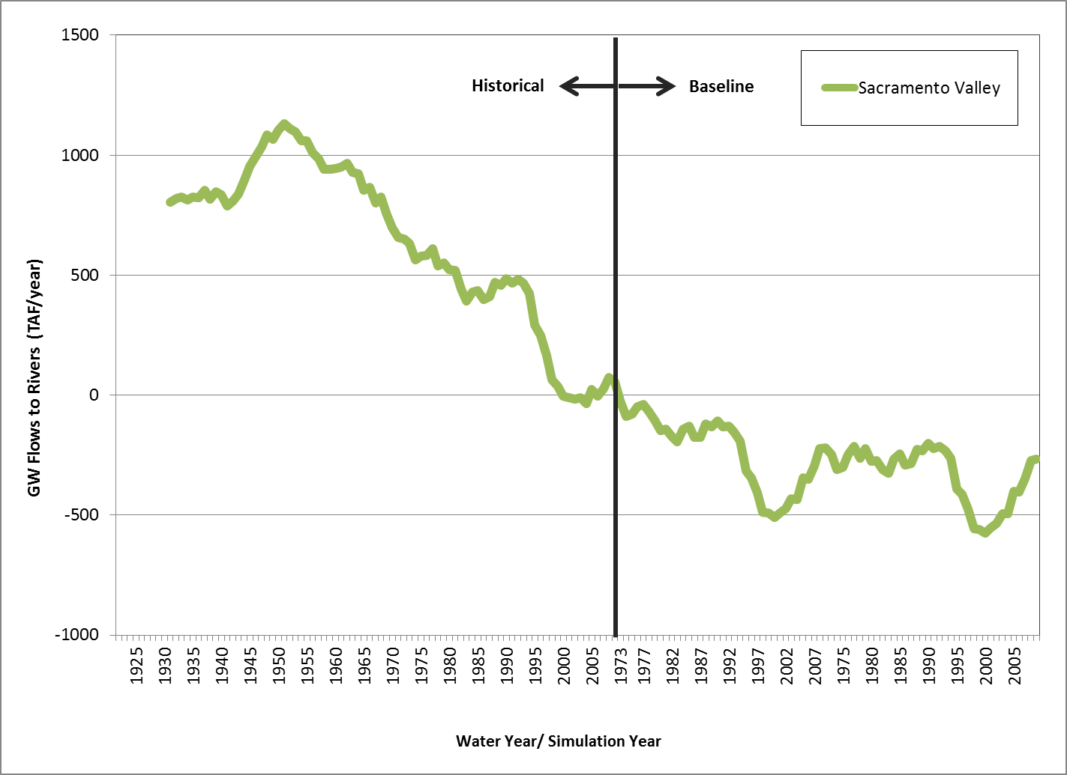
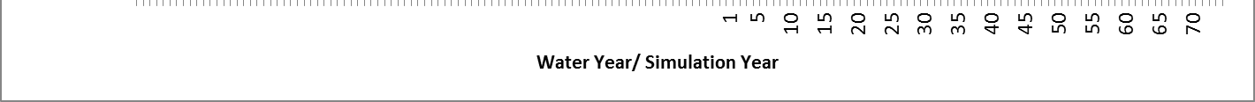
Net Stream Gain & Loss for Sacramento Valley
Historical and Status Quo Future Conditions
PAST
FUTURE
1950’s & 1960’s
900,000 AF
current conditions
“tipping point”
400,000 AF
status quo future
Notes:
-) Lets focus on one component of the water budget – stream gain or loss in Sac Valley
-) This is now from the perspective of the stream so that if the lines are above zero, streams in the region are net gainers of water.
-) When the lines are below zero, streams are losing more water to the GW basin.
-) This graph indicates that
-) When project were being planned the streams had net gain of 900,000 AFY
-) Currently they are about net zero
-) Change results in ~ 30% to 50% less water for export = 300 to 450K AFY
-) In status quo future, they will be losing a net 400,000 AFY of water
-) Another 130 to 200K AFY
-) Total loss of export potential ~350 to 650K AFY
-) So relative to the planning conditions, ~ 1-MAFY less water is showing up at the Delta nowadays, and in a status quo future a further 400,000 AFY loss
-) This directly effects water available at the delta for flushing, export, or other needs
-) The Sac Valley reached this “tipping point” in early 2000’s
-) Let me emphasize, streams in the Sac Valley will be net losers of water in future, even under status quo conditions
-) As we saw, it takes years to decades for pumping effects to fully impact streams

Slide 34
Delayed Intervention
§ 10735.8, subd. (h) [Before January 1, 2025, the State Water Board cannot adopt an interim plan for a probationary basin to address impacts on interconnected surface waters].
§ 10735.2, subd. (a)(5)(B) [Before January 1, 2025, the State Water Board cannot designate a basin as probationary based on impacts on interconnected surface waters].

Slide 35
Baseline
§ 10720.2, subd. (b)(4)
  (b) The [groundwater sustainability] plan may, but is not required to, address undesirable results that occurred before, and have not been corrected by, January 1, 2015.

Slide 36
Groundwater – Surface Water Connection Lost
Before 2015
Dry Stream
Seepage to Groundwater Exceeds Stream Flow
Dry Stream Channel (Intermittently or Year-round)
Further Reduction in Groundwater Levels
Will Not Increase Stream Loses Flow to Groundwater

Slide 37

Pumped Groundwater Basin
Initial Level of Use
High Capacity Wells
Domestic Wells
River
Ground Surface
Groundwater Level
Recharge/Leakage
from River
Notes:
In a basin with a moderate level of pumping
Domestic wells tend not to be as deep
Higher capacity, Agricultural or Municipal wells tend to be deeper, and of course, withdraw more water
Even with modest levels of pumping, groundwater levels have been drawn down below the level of streams that flow across the basin
This induces flow of water from the stream to the aquifer
This stream leakage is part of the recharge to the groundwater basin
If this level of pumping continues, the basin will come to equilibrium
This means levels will stabilize
Although levels may go up and down as wetter and dryer periods pass, overall the levels will remain stable over muliple years
Similarly, leakage rates from the stream to the groundwater will remain relatively constant

Slide 38
Pumped Groundwater Basin
Increased Level of Use
New High Capacity Wells
Stranded Domestic Wells
River
Ground Surface
Increased
Leakage
from River
Groundwater Level
Notes:
If new wells are drilled and pumping is increased
Groundwater levels will go down
This can leave shallower wells, such as many domestic wells “stranded” or high and dry above the groundwater levels
Even if wells are not completely stranded, pumping yield from wells will go down because of lower water levels
Also leakage from the stream to the groundwater increases with lower water levels
This means less flow is left in the stream – and surface water supplies are further impacted
If these pumping rates continue, the groundwater levels may again stabilize, but at lower levels
These levels will stabilize, however, only if enough additional flow can be drawn in from the river to compensate for the increased pumping rates

Slide 39
Independent Authority Unaffected
§ 10720.5
(b) Nothing in this part . . . determines or alters surface water rights or groundwater rights under common law .
§ 10726.8
(c) Nothing in this part is a limitation on the authority of the [State Water] board . . . .

Slide 40
How To IDENTIFY AND Avoid SGMA “Undesirable Result” No. 6:
“Significant And Unreasonable Adverse Impacts On Beneficial Uses Of Surface Waters”
Letty Belin letty.belin@gmail.com
Notes:
My goal was, as the title of the Guide indicates, to help GSAs and stakeholders understand what factors they need to consider and steps they need to take in order to avoid “significant and unreasonable adverse impacts on beneficial uses of surface waters.”

Slide 41
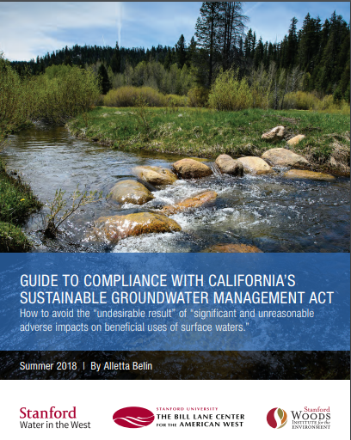
State and federal laws and requirements provide most important guidance
Red Light: Remedial action probably required
Yellow Light: Possible problems; additional analysis needed
Green Light: No apparent risks
Notes:
Stanford Water in the West Publication – I wrote with assistance of others there and elsewhere while a Visiting Fellow last winter and spring
I talked to many legal and technical experts, including people on this panel and a number of people who were involved in negotiating and drafting SGMA and/or have been involved in implementing SGMA
I will Highlight a handful of the key recommendations in this report
Under SGMA “sustainability” is defined as avoidance of 6 “undesirable results”

Slide 42
Overarching principles
Existing legal frameworks – laws, regulations, court decisions – provide clearest guidance on what constitutes UR #6
Groundwater use that causes or contributes to a violation of a state or federal legal requirement relating to beneficial uses of surface water almost certainly constitutes UR #6
Notes:
-- Fundamental points made: bullets 1 and 2 above
-- The guide reviews all the legal requirements that are most likely to give rise to UR #6

Slide 43
Situations Most likely to constitute ur #6:
Where groundwater depletions cause or contribute to violations of requirements established under federal or state statutes:
1. Violation of state or federal endangered species law requirements
2. Violation of state or federal instream flow requirements
Notes:
ESA: Two pertinent provisions: Sections 9 and 7
Section 9 prohibits persons from unlawful “take” of listed species;
Section 7: requires that federal agencies avoid (1) jeopardizing the continued existence of listed species and (2) adversely modifying habitat that has been found to be critical for the species survival
Even though GSAs aren’t federal agencies, they need to ensure that groundwater depletions are neither jeopardizing the continued existence of the species nor adversely modifying critical habitat.
ESA example: where it is known that groundwater depletions are adversely affecting river flows in critical habitat of listed fish – e.g., causing or contributing to drying up of river stretches at times that clearly harm listed fish – that is a problem

Slide 44
3. Violation of state or federal surface water quality requirements
4. Impairment of flows of rivers designated as “wild and scenic”
5. Adverse effects on surface waters within specially protected areas (e.g., national parks or monuments, national wildlife refuges, wilderness areas, wilderness study areas, national recreation areas, etc.)
Notes:
Water quality requirements can be established under either state or federal law by the State or Regional Water Boards
Understanding what needs to be done where groundwater depletions are contributing to water quality violations in surface water may be complicated
I would recommend meeting with relevant experts at either the Regional Board or the State Board to get their input on an appropriate course of action
Violations of WQS legal requirements can also potentially constitute UR #4: “significant and unreasonable degraded water quality, including the migration of contaminant plumes that impair water supplies”
Impairment of flows in designated W & S rivers or other protected areas centers on language of governing statutes and regs and nature of impairment

Slide 45
Where groundwater depletions cause or contribute to violations of other legally protected surface water rights or resources:
Impairment of senior surface water rights
adverse effects on groundwater dependent ecosystems (GDEs) protected under public trust doctrine
Notes:
Addressed by Dave Owen
Senior water rights: There aren’t many. Federal reserved rights, tribal treaty and fishing rights, and adjudicated state-based pueblo water rights (adjudicated only in LA, San Diego)
Public trust: GDEs must be either navigable waters or directly connected to navigable waters
The purpose of the public trust is to protect navigation, fishing, recreation, environmental values, and fish and wildlife habitat

Slide 46
Additional advice on how to avoid ur No. 6
Developing the GW data and models to accurately determine impacts of pumping on surface water beneficial uses may take years
  Strategies to avoid UR No. 6 likely to evolve over time as data improves
Coordinate and collaborate with other agencies and stakeholders in acquiring data/facts and identifying solutions
  UR No. 6 may be linked to multiple causes; solutions will require coordination among multiple parties

Slide 47
Additional advice on how to avoid ur No. 6 (cont’d)
When both groundwater depletions and other factors cause UR #6
  Take reasonable steps to estimate degree of contribution to the problem
  Contact other potentially responsible parties to seek collaborative strategy addressing problem
  Incorporate remedial steps into Groundwater Sustainability Plan

Slide 48
Additional advice on how to avoid ur No. 6 (cont’d)
Follow EDF’s recommendation to maintain 2014 groundwater levels
  Caveat: This course of action does not guarantee avoidance of UR #6 in all circumstances
    Legal requirements may change over time (e.g., new fish species are listed as endangered; new water quality requirements are established)
    Impacts of pumping on surface waters may be delayed
Notes:
Citation to report on this issue by Maurice Hall and Christina Babbitt is included on page 1 of my guide.
This is definitely a good rule of thumb and a good starting point for avoiding UR #6. But be aware it may not be all that is needed over time.
Tara: Problems arise especially where GW pumping is far from the surface water and there is a lag time before impacts are fully apparent. By the time the groundwater levels decline it may be difficult to undo the problematic impacts on surface water.

Slide 49
Stanford Water in the West
https://purl.stanford.edu/kx058kk6484
Notes:
We have hard copies of the report here
Also the electronic version of the report is provided at Water in the West’s website

Slide 50
DRAFTING SGMA GROUNDWATER PLANS
WITH FISHERIES IN MIND
2019 WLS Panel on Interconnected Groundwater & Surface Water
PAUL STANTON KIBEL
PROFESSOR, GOLDEN GATE UNIVERSITY (ggu) SCHOOL OF LAW
DIRECTOR, ggu ceNTER ON Urban Environmental Law (CUEL)
Natural resource counsel, water and power law group

Slide 51
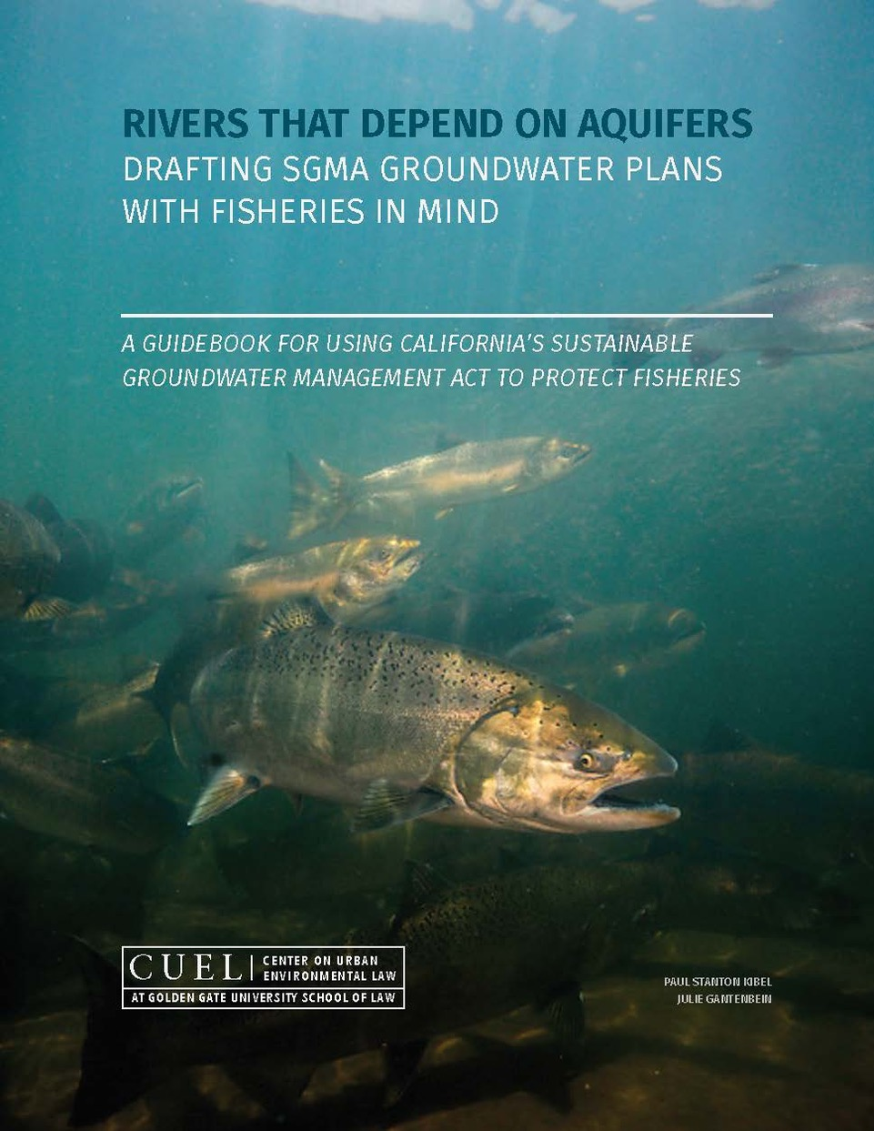
AUGUST 2018 RELEASE OF CUEL GUIDEBOOK ON SGMA & FISHERIES

Slide 52
A HIDDEN CONNECTION –
GROUNDWATER PUMPING, SURFACE FLOWS & FISHERIES
The Groundwater-Fisheries Connection
› Under California Water Law, Surface Waters Have Historically Been
Regulated As If They Were Hydrologically Unconnected to Groundwater
› Yet Many Rivers in California that Support Fisheries Such as Salmon and Trout are Hydrologically Dependent on Tributary Groundwater to Maintain Instream Flow
› When There is Intensive Pumping of Tributary Groundwater the Result Can Be Reductions in Instream Flow and Damage to Fisheries

Slide 53
‘BENEFICIAL USES’ OF WATER IN CALIFORNIA
SGMA Statute: The objective of SGMA is to avoid six specified “undesirable results” including (No. 6) the “depletion of interconnected surface waters that have significant and unreasonable impacts on beneficial uses of surface waters”
State Water Board Bulletin No. 116
Designated “Beneficial Uses” of Water Include:
› Supporting “cold water ecosystems including but not limited to preservation or enhancement of…fish”
› Supporting “high quality aquatic habitats suitable for reproduction and early development of fish”
› Supporting “habitats necessary for migration or other temporary activities by aquatic organisms, such as anadromous fish”

Slide 54
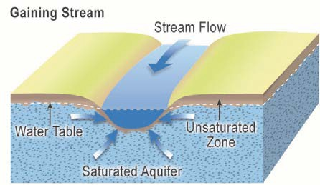
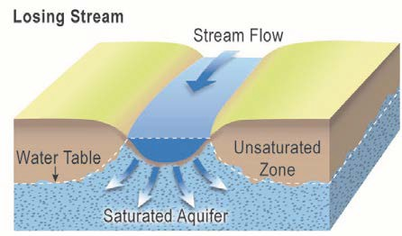
PICTURING THE CONNECTION
Aquifers, Gaining Streams/Losing Streams and Surface Water Flows for Fisheries

Slide 55
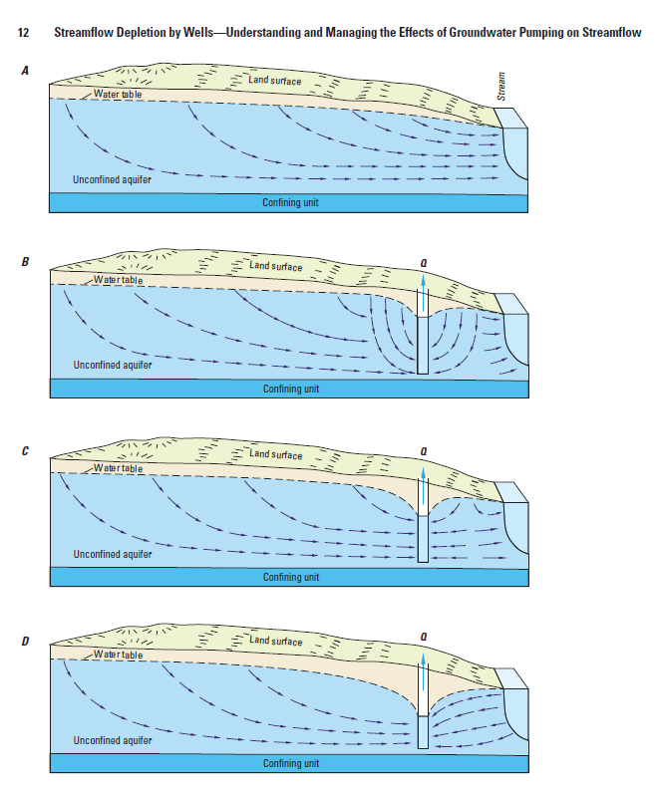
PICTURING THE CONNECTION
‘Cones of Depression’ and the Lateral Location of Groundwater Wells

Slide 56
PICTURING THE CONNECTION
Key Habitat Parameters for Fisheries Related to
Groundwater Pumping’s Effect on Interconnected Surface Water Flows
› Water Temperature for Coldwater Fisheries (Salmon/Steelhead)
› Acute Seasonal Instream Flow Needs of Fisheries at Times of Year When Juvenile Salmon/Steelhead Migrate Downstream
› Maintaining Connectivity Between Mainstem Rivers and Tributary Creeks That Serve as Coldwater Refuges for Salmon/Steelhead During Summer/Early Fall

Slide 57
FRAMING THE CONNECTION: MODELIING & WATER BUDGETS
SGMA Regulations and Guidance Related to Fisheries
› SGMA Regulation 354.16 provides GSP hydrogeologic conceptual models must include “identification of interconnected surface water systems and an estimate of the quantity and timing of depletions of those systems”
› SGMA Best Management Practices for Modeling (December 2016 Guide by California Department of Water Resources): “The water budget shall quantify… inflow to the groundwater systems by sources type, including…surface water systems…and shall quantify…outflows from the groundwater system, including…groundwater discharge into surface water sources”

Slide 58
FRAMING THE CONNECTION: MINIMUM THRESHOLDS & MONITORING
SGMA Regulations and Guidance Related to Fisheries
› SGMA Regulation 354.34 and 354.28 provides that GSPs must provide “minimum thresholds” for “the “rate or volume of surface water depletions caused by groundwater use that has adverse impacts on beneficial uses of the surface water” and shall be supported the “location, quantity and timing of depletions of surface water”
› SGMA Best Management Practices on Monitoring Networks (December 2016 Publication by California Department of Water Resources) provides that GSP monitoring networks for depletions of interconnected surface water must characterize “flow conditions indicating surface water discharge….identifying the approximate date and location where ephemeral or intermittent streams and rivers cease to flow…and temporal changes in conditions due to variations in stream discharge and regional groundwater extractions”

Slide 59
SOFTWARRE/MODELS TO ASSESS IMPACTS OF
GROUNDWATER PUMPING ON FISHERIES IN GSPs
› Software and models are now available to quantitatively evaluate the impact of groundwater pumping on interconnected surface water flows (presented in United States Geological Survey Circular 1376 titled Streamflow Depletion by Wells – Understanding and Managing the Effects of Groundwater Pumping on Streamflow, 2012 publication)
› Software and models are now available to evaluate the impacts of reduced surface water flows on fisheries and fisheries habitat, such as SALMOD (software developed by United States Geological Survey in 1994) and the IOS Model (Interactive Object-Oriented Simulation Model)
› The availability of such software and models make it difficult for GSAs to credibly claim that it is not feasible or is too speculative to analyze the impacts of groundwater pumping on fisheries in SGMA GSPs

Slide 60
CONCLUSION – FISHERIES UNDER SGMA
The Five Key Take-Aways in the August 2018 CUEL SGMA Fisheries Guidebook
› (1) Temporal Focus is on Times When Fisheries Need Instream Flow, Not on the Long-Term Average Maintenance of Groundwater Table
› (2) Lateral Location of Groundwater Wells Can Affect Impacts on Nearby Surface Water Flows and Fisheries (Cones of Depression)
› (3) Fisheries May Be Impacted by How Groundwater-Surface Water Interactions Affect Instream Surface Water Temperatures
› (4) Absence of Complete Data is Not a Proper Basis for SGMA Groundwater Plans to Omit Provisions Addressing the Impacts of Groundwater Pumping on Surface Flows and Fisheries (Best Science Available)
› (5) In Approving and Implementing SGMA Groundwater Plans, GSAs Are Subject to the Requirements of California Public Trust Law As Well As SGMA

Slide 61
DRAFTING SGMA GROUNDWATER PLANS
WITH FISHERIES IN MIND
2019 WLS Panel on Interconnected Groundwater & Surface Water
PAUL STANTON KIBEL
PROFESSOR, GOLDEN GATE UNIVERSITY (ggu) SCHOOL OF LAW
DIRECTOR, ggu ceNTER ON Urban Environmental Law (CUEL)
Natural resource counsel, water and power law group

Slide 62
The Scott River Litigation & Its Legacy—Groundwater & the Public Trust Doctrine
California Water Law Symposium
UC Hasting College of the Law
February 2, 2019
Richard Frank

Slide 63
The Public Trust Doctrine
Origins in Roman, English, Spanish & Mexican Law
Over past 50 years, has evolved into a cornerstone principle of environmental, natural resources and water law

Slide 64
The Public Trust Doctrine
Certain natural resources are incapable of private ownership, and are held in trust, for benefit of current & future generations
Government managers of public trust have affirmative (“trustee”) obligation to manage trust resources, with goal of long-term resource protection & preservation

Slide 65
The Public Trust Doctrine
Incorporates principle of sustainable development
And principle of intergenerational equity

Slide 66
Public Trust Purposes:
Traditionally: commerce, navigation and fishing
Modern: [also] recreation, ecological study, open space, aesthetics (Marks v. Whitney (1971))

Slide 67
Natural Resources Subject to Public Trust:
Traditionally: tide and submerged lands; beds of navigable waterways; fish and wildlife resources
Modern: ???

Slide 68
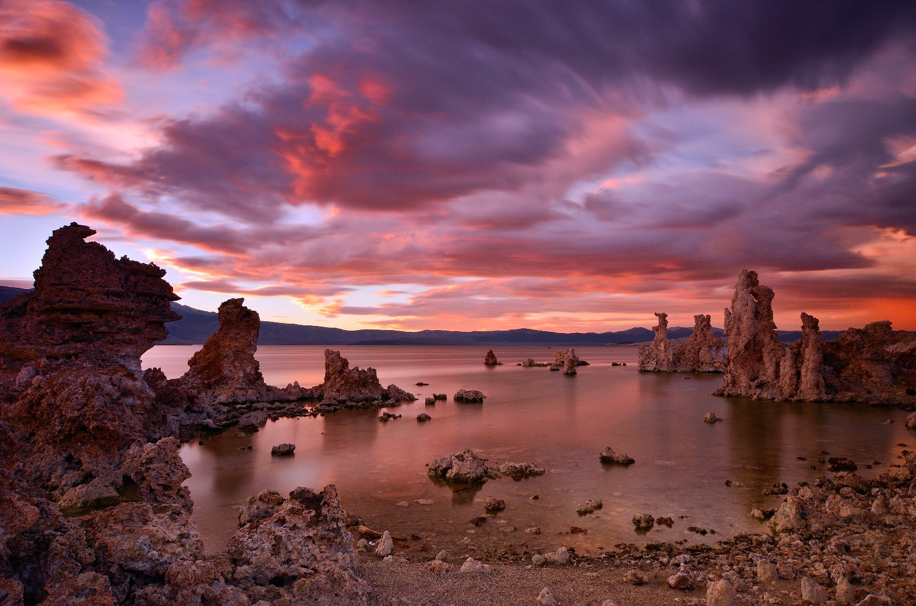
National Audubon Society v. Superior Court, 33 Cal.3d 419 (California Supreme Court 1983)

Slide 69
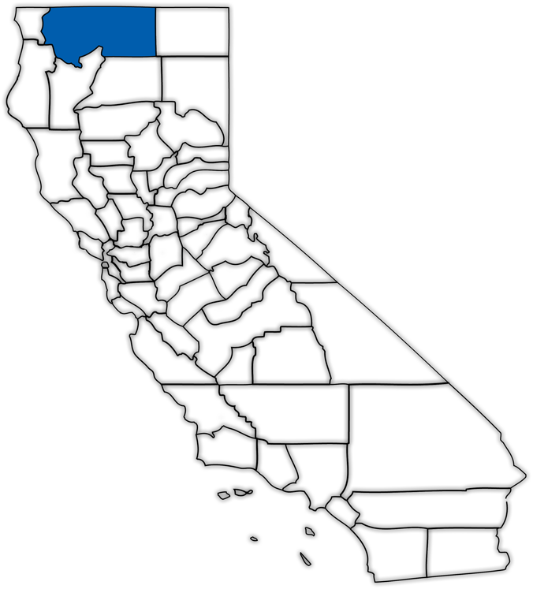
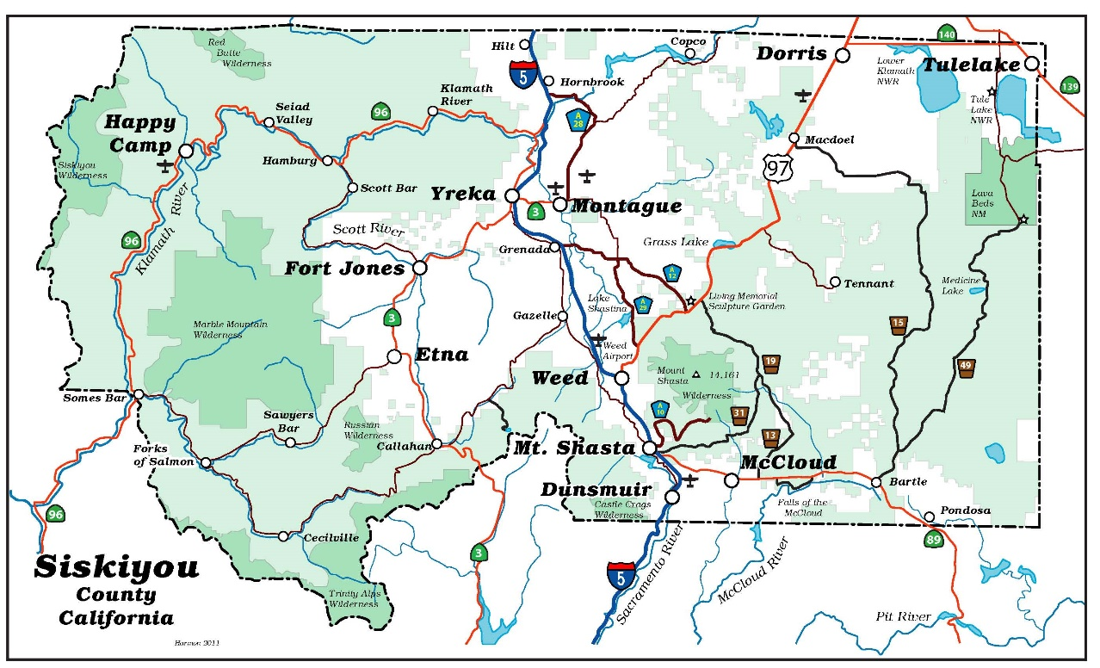
Siskiyou County

Slide 70
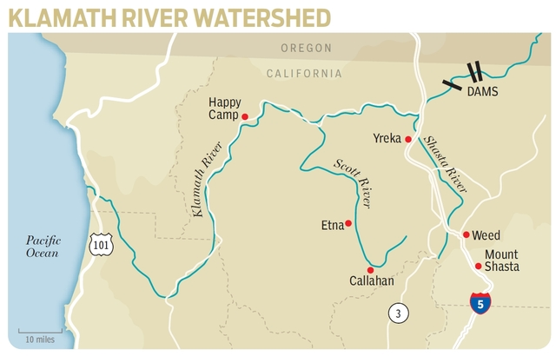
Klamath & Scott Rivers

Slide 71
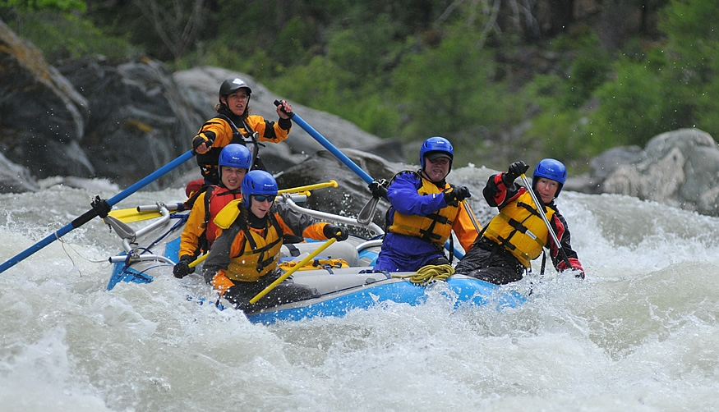
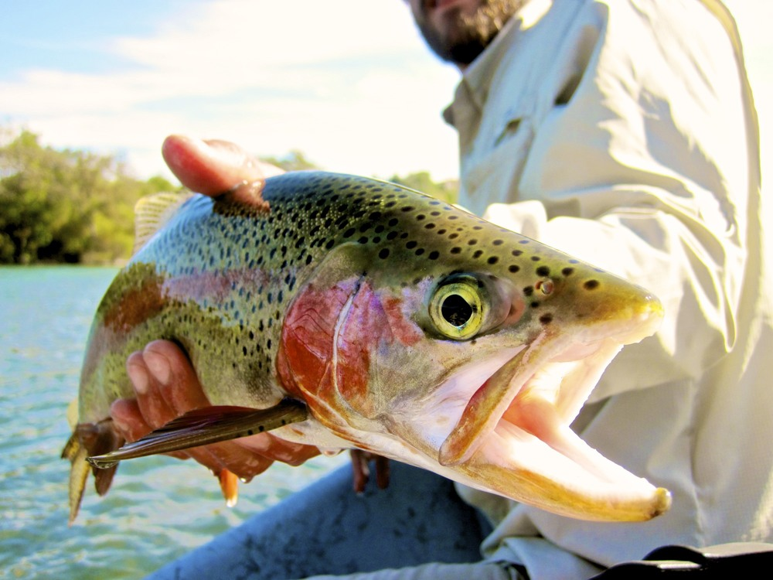
Scott River

Slide 72
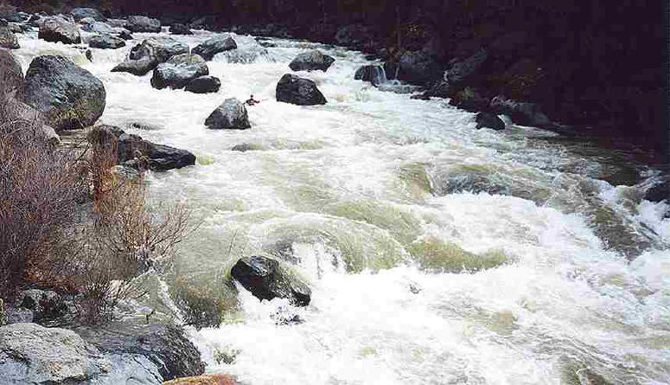
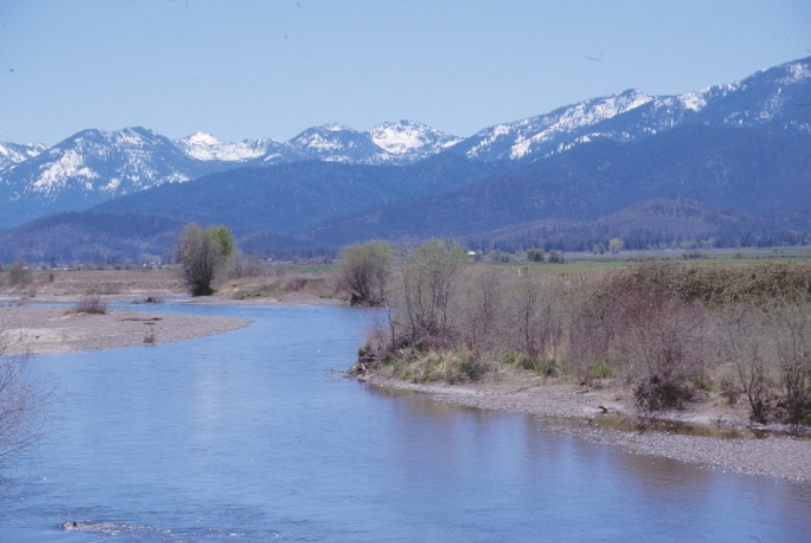
Scott River, then…

Slide 73
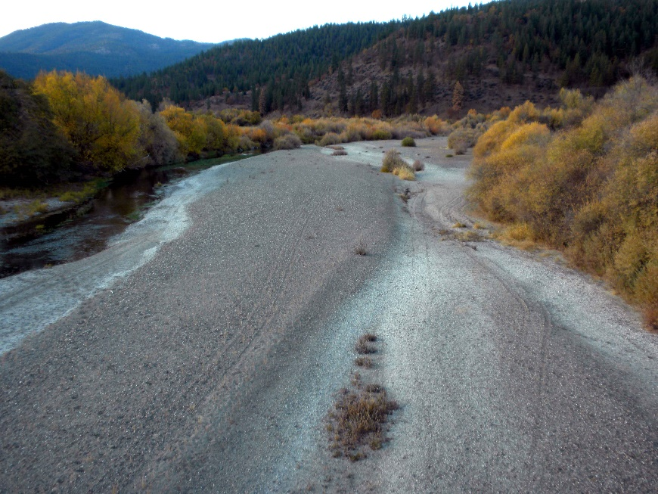
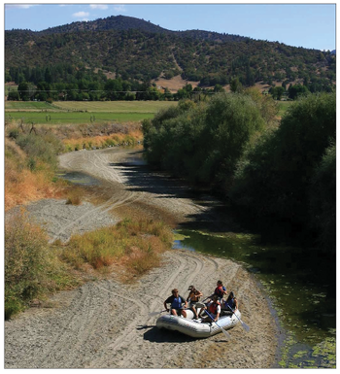
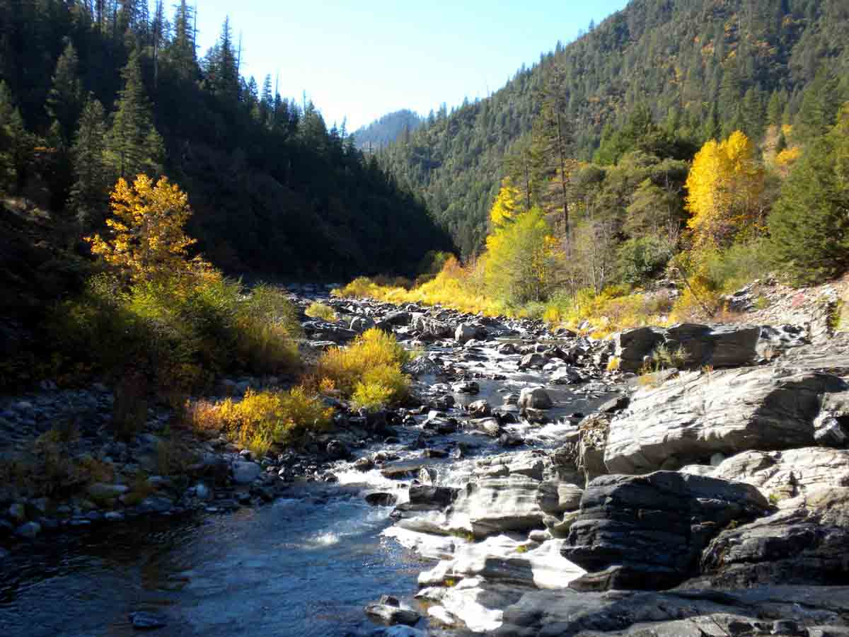
…and now

Slide 74
Environmental Law Foundation v. State Water Resources Control Bd.,
(Sacramento County Superior Court)
Filed in June 2010
Petitioners: Environmental Law Foundation; Pacific Coast Federation of Fishermen’s Associations; Institute for Fisheries Resources
Respondents: Siskiyou County; State Water Resources Control Board

Slide 75
Key Factual Claims:
Scott River is a navigable waterway
Established hydrologic connection exists between surface flow & groundwater in Scott River Valley
Scott River has experienced dramatically reduced flows in recent years due to expanded & unregulated groundwater pumping in Valley; resulting impacts include:
  Harm/destruction to migratory salmon in Scott River
  Harm/elimination of public recreational opportunities on Scott River

Slide 76
Key Legal Claims:
SWRCB & County have authority under public trust to protect trust resources of Scott River region
Both agencies have disclaimed authority or obligation to do so (re: groundwater)
Court should issue order requiring Scott Valley groundwater to be managed consistent w/public trust doctrine

Slide 77
The Decision:
Environmental Law Foundation v. SWRCB (August 29, 2018) 26 Cal.App.5th 844
Case is fully justiciable
Public trust doctrine applies to extraction of groundwater that adversely affects a navigable waterway
Sustainable Groundwater Management Act does not displace operation of the public trust doctrine as to interconnected groundwater
Both SWRCB and local governments have affirmative duty to protect trust values in GW

Slide 78
For discussion:
Post-ELF, how does the public trust doctrine interrelate with the requirements of the
Sustainable Groundwater Management Act?

Slide 79
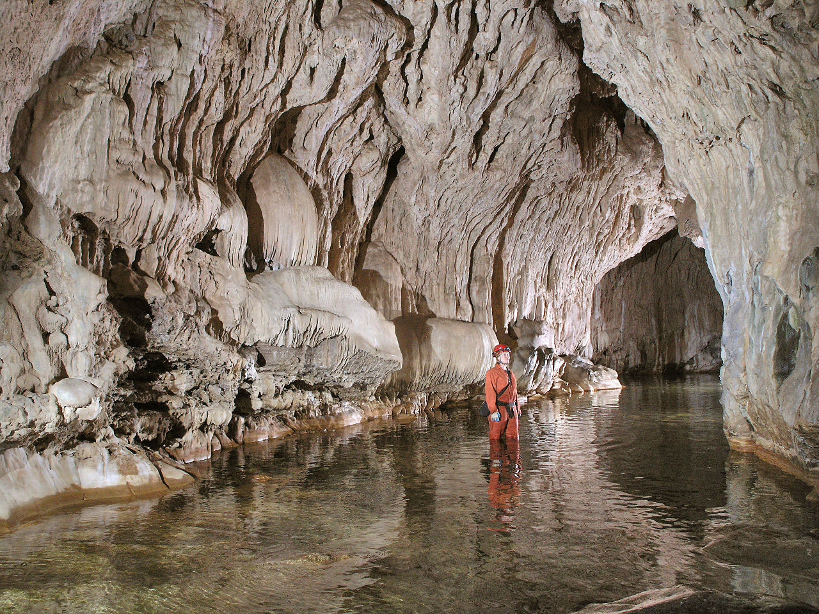
Questions?
Natural Bridges
Photo: USBR

