Slide 1
Tuolumne River FERC relicensing process
1/30/2021
Michael Frantz
Turlock Irrigation District Director

Slide 2
Turlock Irrigation District Background
Founded in 1887, oldest irrigation district in the state
Governed by a locally elected Board of Directors
Not part of the State or Federal water project
Locally owned, funded, and operated
Sustainable farming (serve same footprint as 130 years ago. Average parcel size is 30 acres. Multi-generational family farms)
Our community is dependent on the Tuolumne River
11 disadvantaged communities in irrigation service territory (DWR)
Flood control responsibilities for the Tuolumne
MID / TID Partnership, CCSF / Hetch Hetchy

Slide 3
Relicensing/Licensing Overview
Started in 2010, license expired in 2016
Districts selected the Integrated Licensing Process (ILP)
District’s responsibility to mitigate the project impacts
Climate Change studies not required by FERC
Districts developed site specific science on the Tuolumne, our FLA based on the results
Over $35million spent on 40 collaboratively designed (ILP) studies
Studies conducted by experts in their fields
Over $50M total spent to date- paid for by customers
Don Pedro value = $4B to our region

Slide 4
Historical Watershed Deviation

Slide 5
Operational Adaptation For Climate Change
Climate change isn’t a theoretical problem for TID, it is something that we must adapt and mitigate for
We aren’t here to speculate, but to operate the river for the benefit of our community
We believe data and technology are the best tools to better inform our operations
First watershed to partner with NASA on the Airborne Snow Observatory (ASO)
Partnered with the Scripps’ Institute to incorporate Atmospheric River research into our operations

Slide 6
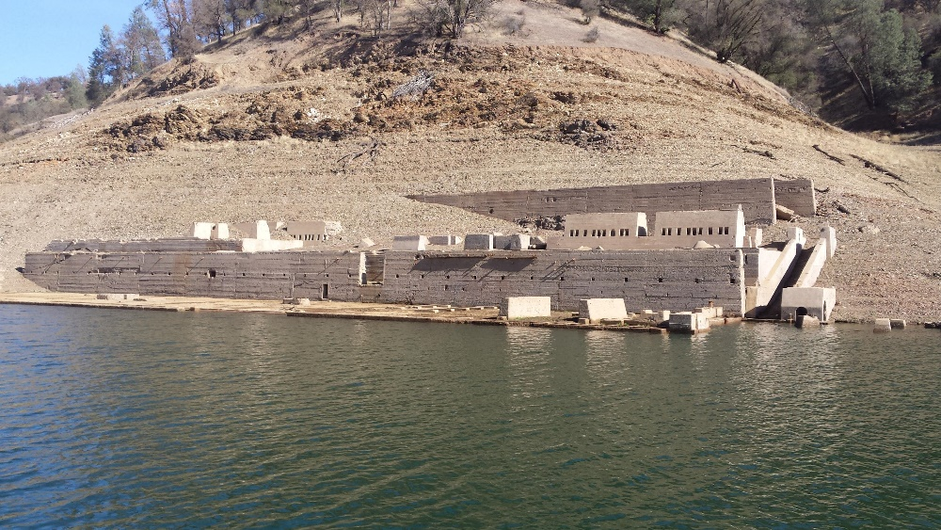
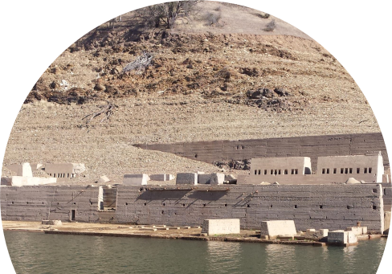
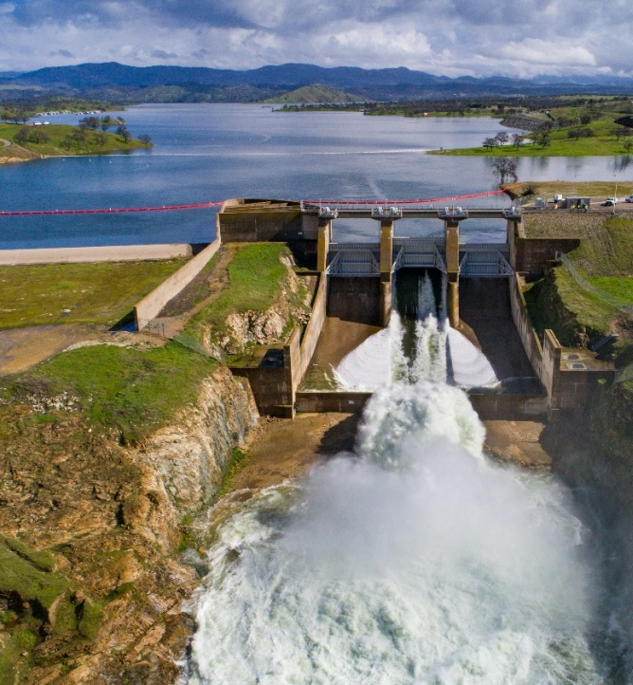
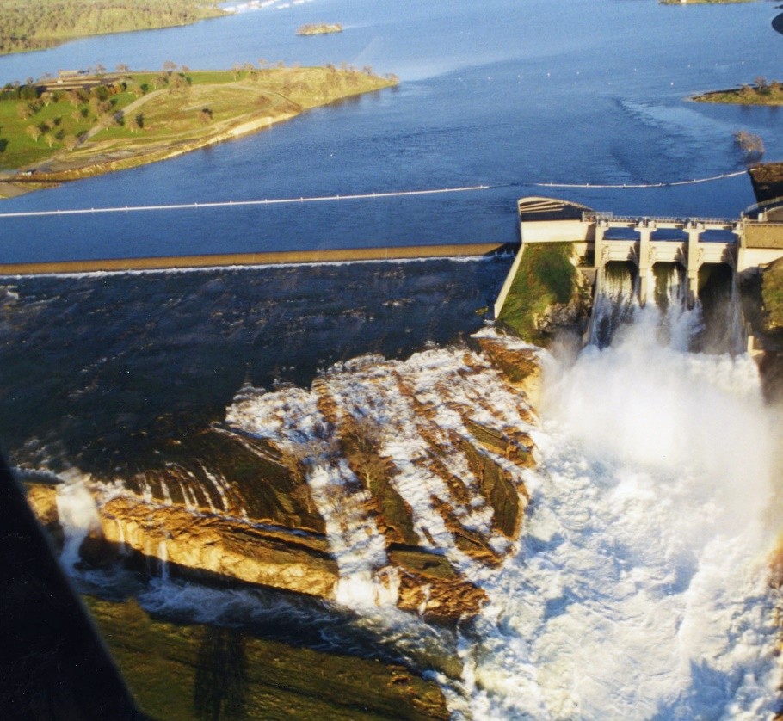
1977, 1997, 2014, 2017

