Slide 1
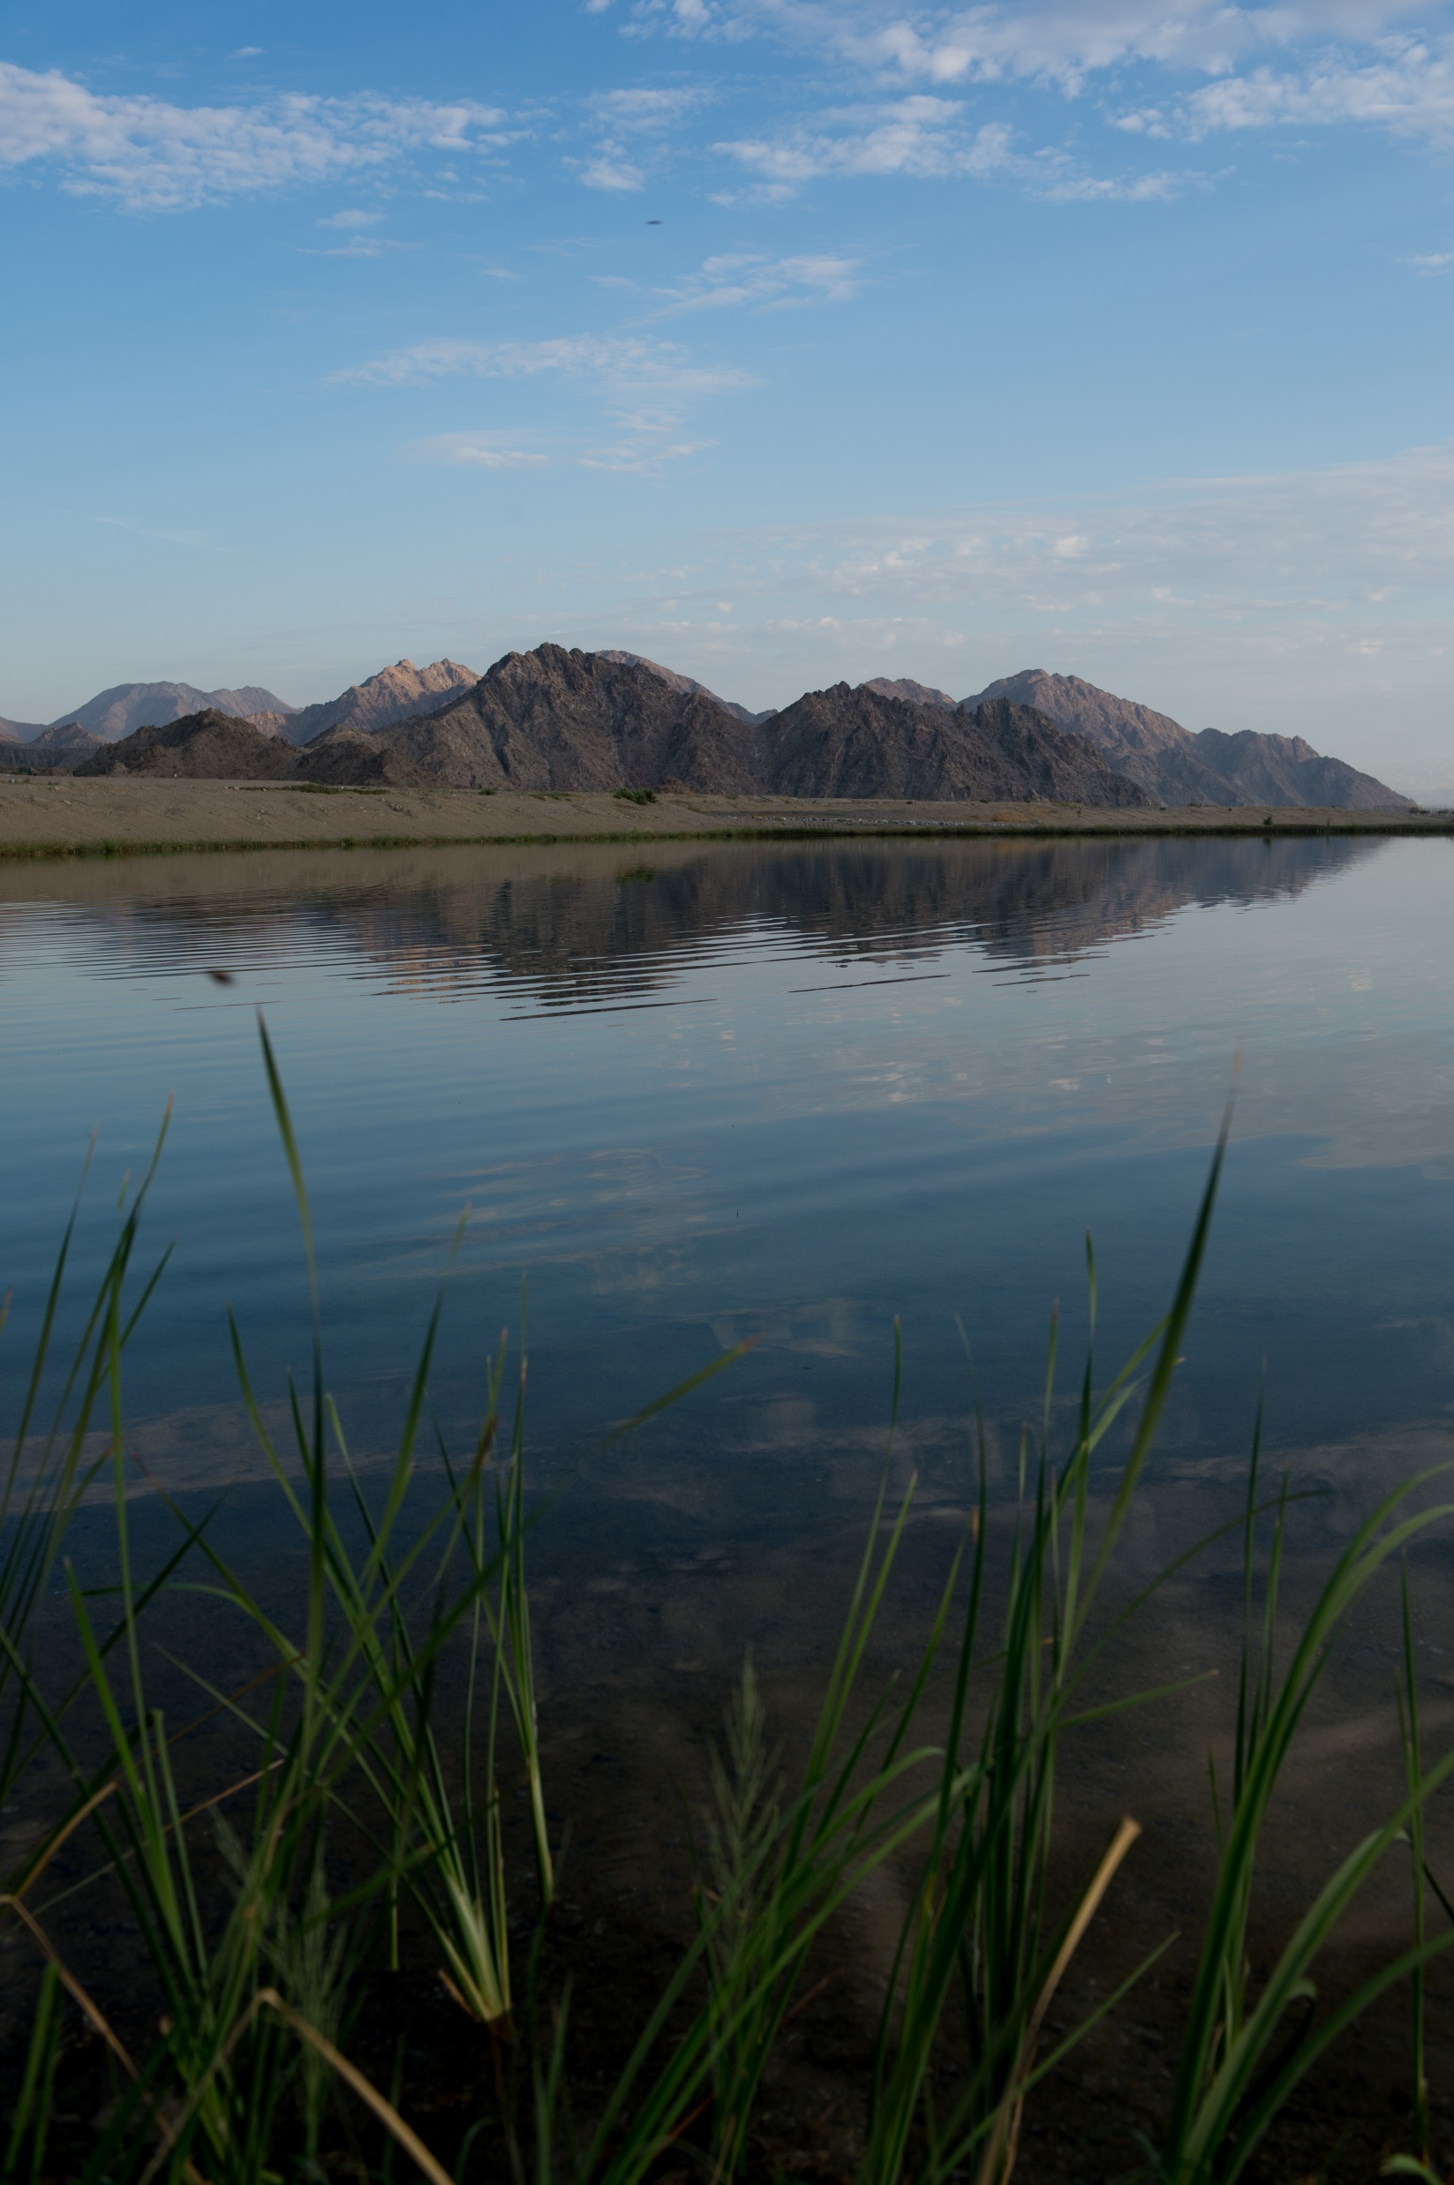
Meeting the Climate Challenge: Groundwater Storage & Headwaters Management 2021 California Water Law Symposium
Tina Cannon Leahy, JD
Senior Staff Counsel
State Water Resources Control Board

Slide 2
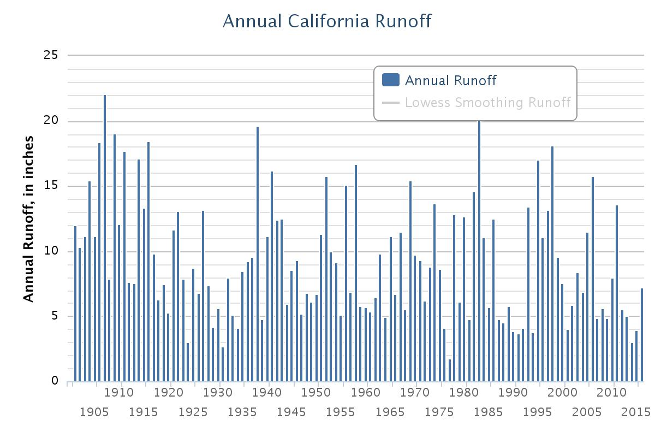
Image credit: U.S. Geological Survey

Slide 3
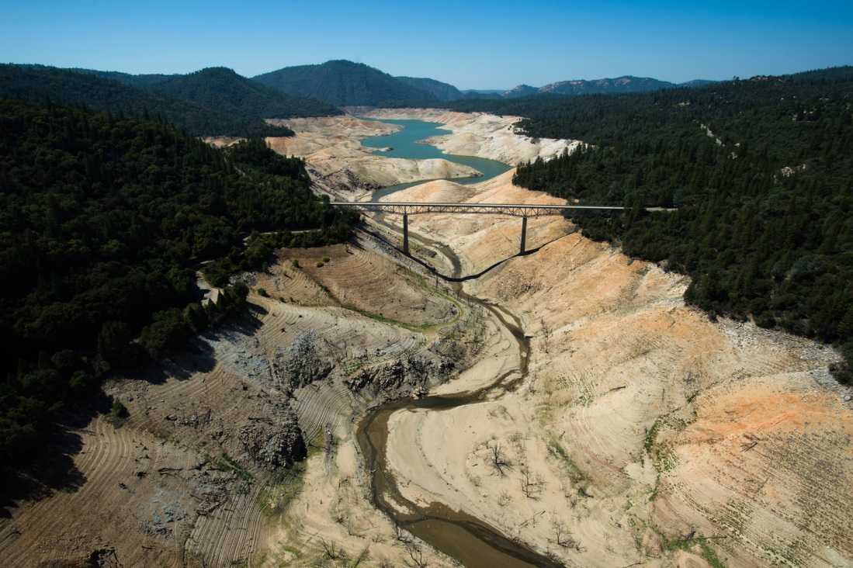
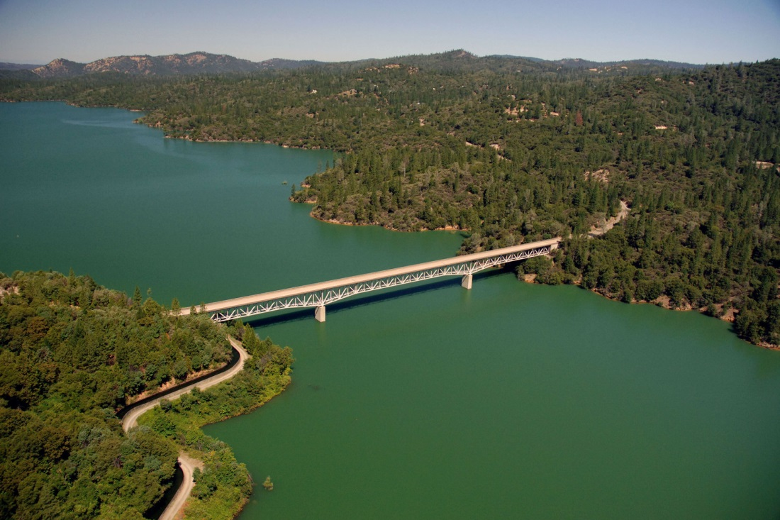

Slide 4
Groundwater Rights & the Legal Fiction
Percolating Groundwater
Overlying
Appropriative
Prescriptive rights
Reserved rights
Pueblo rights
“Subterranean Streams”
Groundwater treated as separate from surface water except “groundwater flowing in known and definite channels” permitted like surface flows
All subject to Cal. Const. art. X, § 2 prohibition on waste and unreasonable use
Coachella recharge pond

Slide 5
SGMA Basics
Form
Agencies
Implement
Plans
Develop
Plans
Achieve Sustainability!

Slide 6
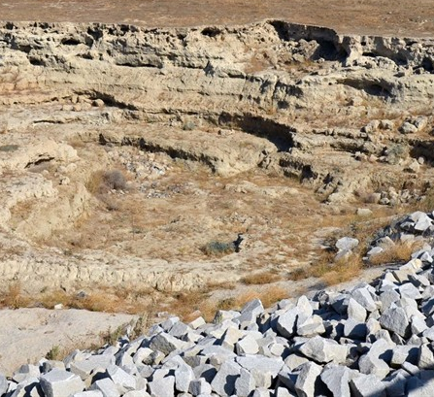
Application of SGMA
SGMA (Wat. Code, § 10720 et seq.)
Applies to high and medium priority groundwater basins in California.
Alluvial basins that the California Department of Water Resources has ranked under the CASGEM program and determined are the most relied upon
Together these basins and subbasins (SGMA doesn’t distinguish) account for about 95% of all groundwater pumped in California
The Act exempts adjudicated basins from most provisions except reporting

Slide 7
Requirements of SGMA
Local public agencies – meaning local agencies with water supply, water management, or land use responsibilities within gw basins subject to the Act – must form groundwater sustainability agencies (GSAs)
GSAs are responsible for developing and implementing groundwater sustainability plans (GSPs)
Plans must use a 50-year planning horizon and achieve sustainability within 20 years
Act allowed local public agencies claiming to have been sustainable over a period of at least 10 years to submit existing plans as an “alternative that meets SGMAs objectives” for the basin (DWR accepted some and rejected some)

Slide 8
To achieve sustainability GSAs must avoid
the six SGMA “deadly sins”
Why these metrics?
Why not “safe yield” or “sustainable yield”
Why is each qualified by “significant and unreasonable”?

Slide 9
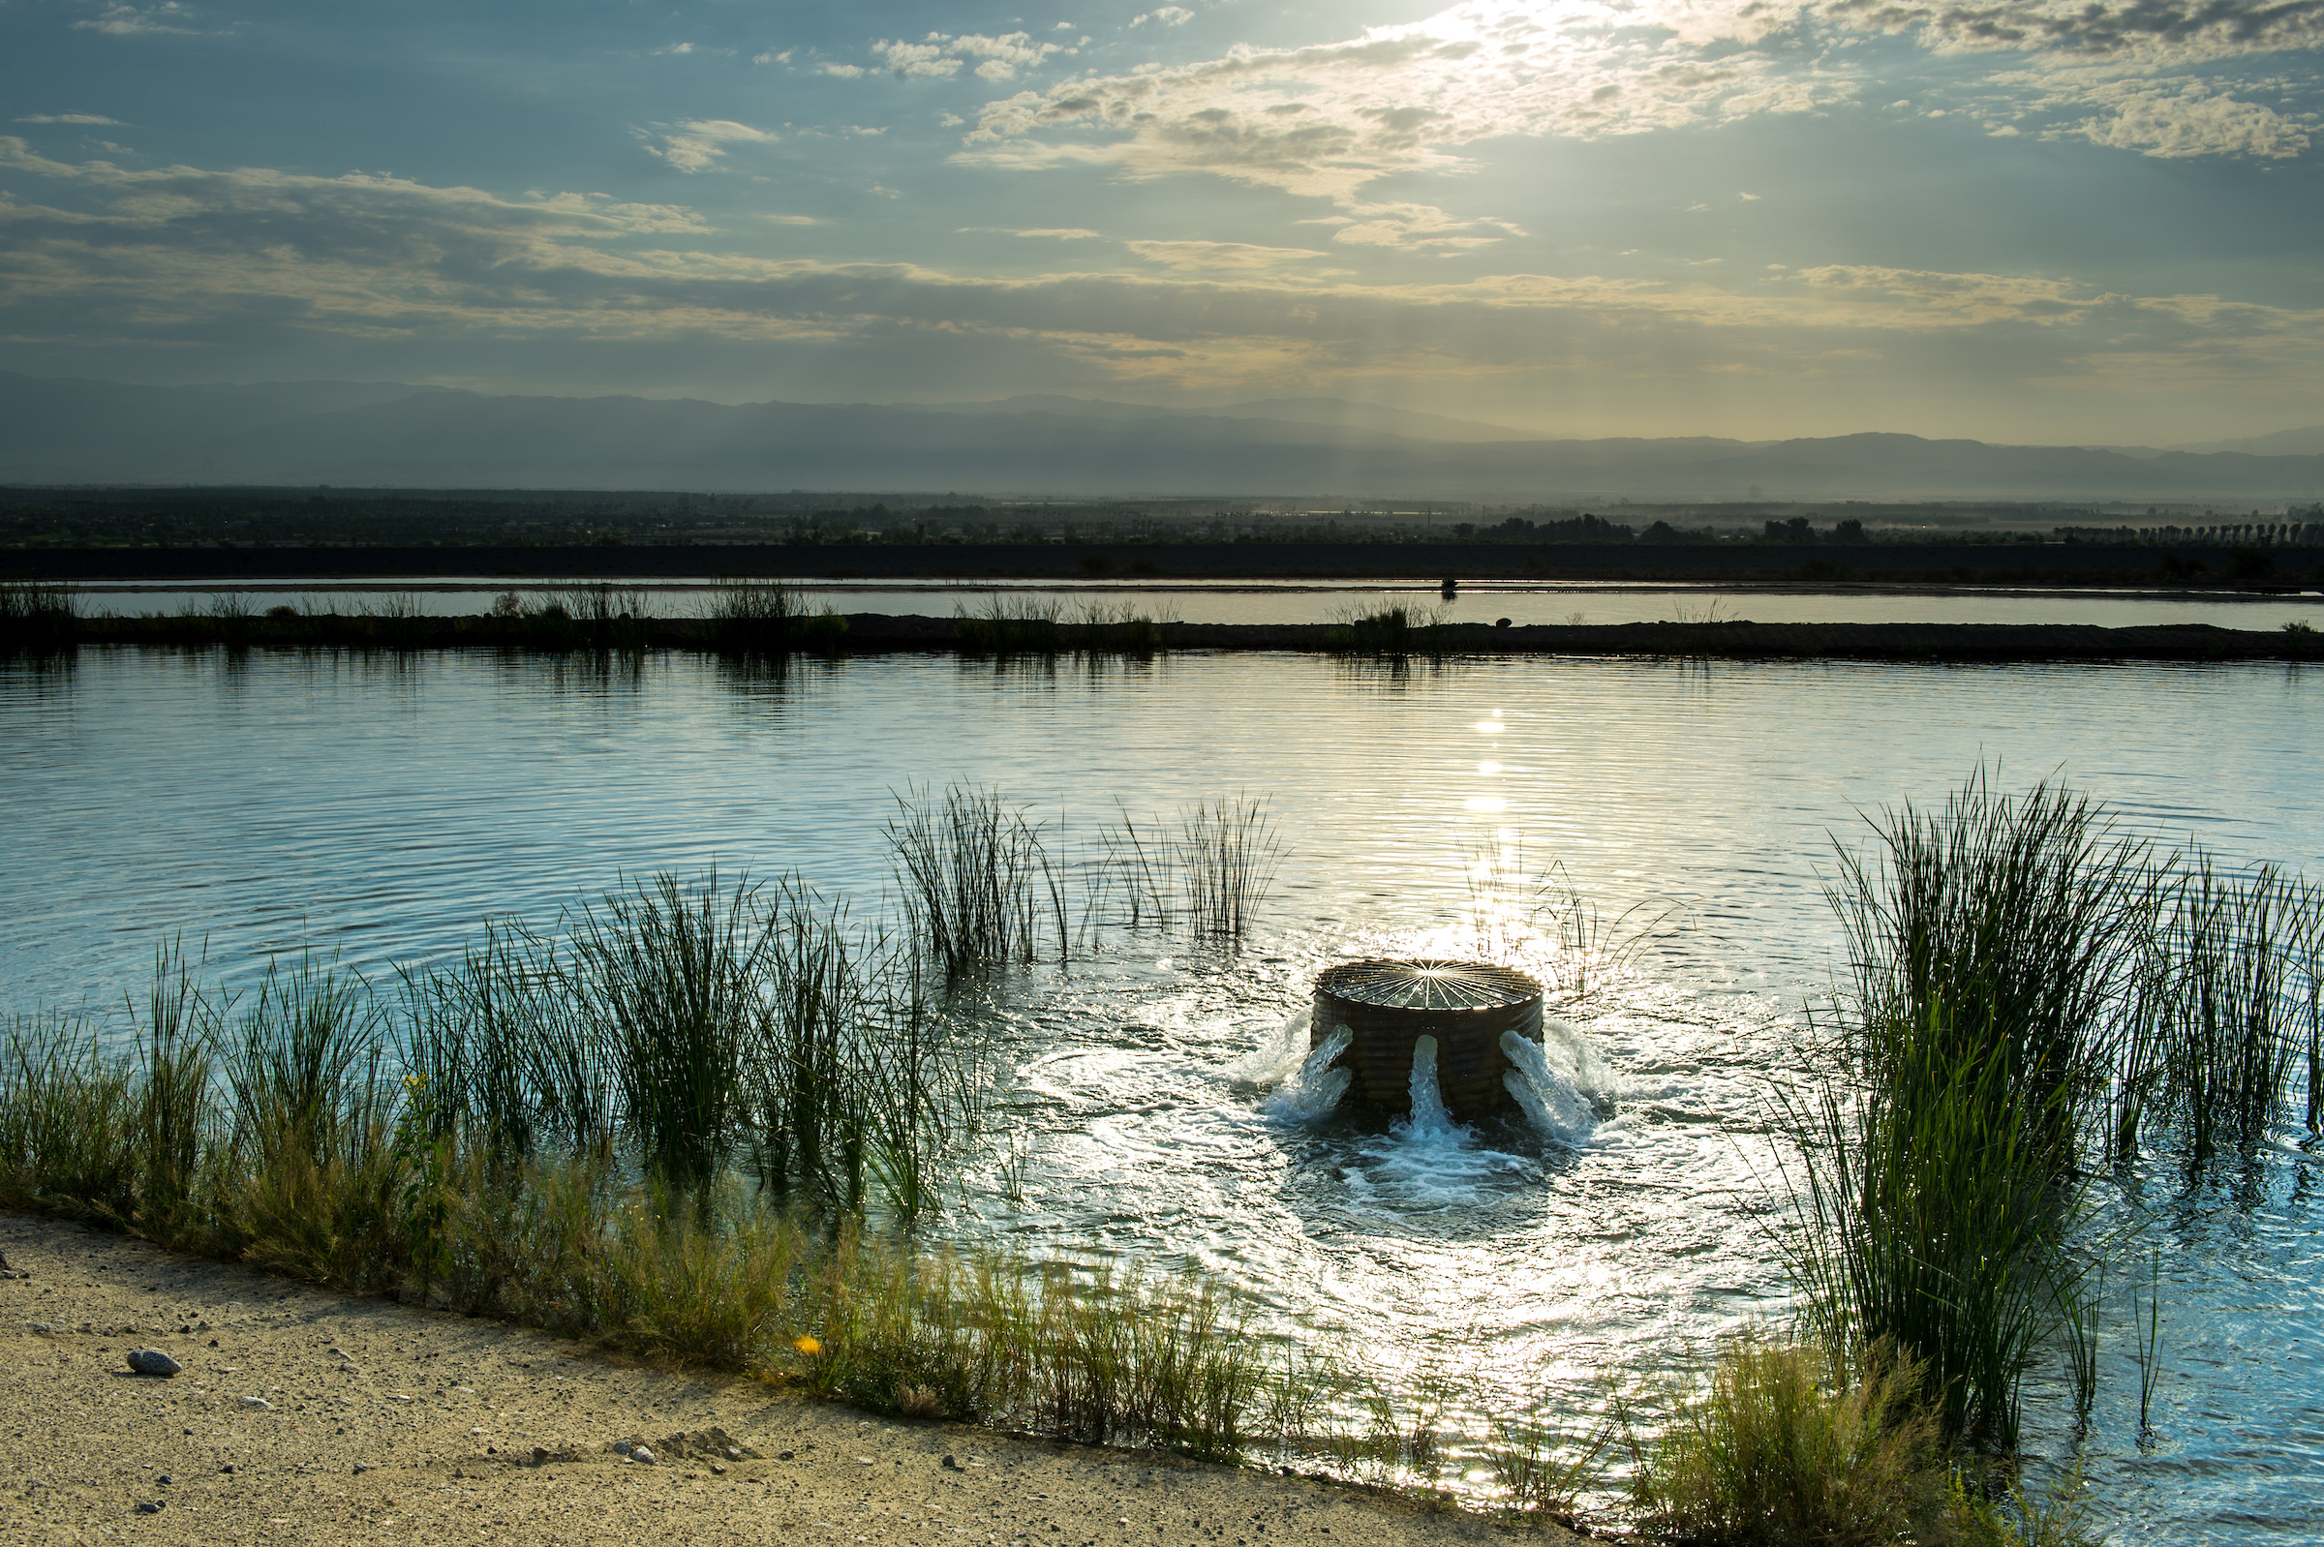
State Intervention

Slide 10
“
[ ]
W here a local groundwater sustainability agency is not managing its groundwater sustainably, the state needs to protect the resource until…a local groundwater sustainability agency can sustainably manage the groundwater basin.
”
California Legislature

Slide 11
TRIGGERING the BACKSTOP
2017
2020
2022
2025
2017
2020
2022
2025
No GSA
or
Alternative
Critical overdraft
&
No plan or
DWR fails plan
No plan
or
DWR
fails plan
DWR fails plan
because of
Surface depletions
No GSA
or
Alternative
Critical overdraft
&
No plan or
DWR fails plan
No plan
or
DWR
fails plan
DWR fails plan
because of
Surface depletions

Slide 12
groundwater BASIN
Probationary
Opportunity to fix issues but…
Wat. Code § 5202(a)(1) All pumpers report to the State Water Board Wat. Code § 1529.5 Fees for Board administration Wat. Code § 10735.2 Board may require meters
De Minimis users are not exempt

Slide 13
Interim Plan
Wat. Code, § 10735.6 – Developing Interim Plan
Probationary basin fails to remedy deficiencies within a year
Wat. Code, § 10735.8 – Adopting Interim Plan
Notice & Hearing
Board identifies actions necessary to correct overdraft
Specifies a time schedule
Requires monitoring
May impose:
Restrictions on groundwater extractions
A physical solution
Principles and guidelines for administering interconnected surface water rights

Slide 14
Water Code § 1242
“The storing of water underground, including the diversion of streams and the flowing of water on lands necessary to the accomplishment of such storage, constitutes a beneficial use of water if the water so stored is thereafter applied to the beneficial purposes for which the appropriation for storage was made.”

