Slide 1
finding the balance: economic sustainability v. water quality 2019 California Water Law Symposium Tess Dunham Somach simmons & Dunn

Slide 2
The Purpose of CVSALTS
Farming/Central Valley Communities
Legal Viability
Economic Viability
Water Quality
Long Term Sustainability
Beneficial Uses
Safe Drinking Water

Slide 3
Current Permitting Requirements
“The Water Boards will evaluate all existing Waste Discharge Requirements to determine whether existing regulatory permitting is sufficiently protective of groundwater quality…”
SWRCB Report to Legislature, 2013
In areas where groundwater quality is poor and there is no more assimilative capacity available, discharges to the basin must not exceed the applicable water quality standard.
SWRCB WQO #73-04 and WQO #81-05

Slide 4
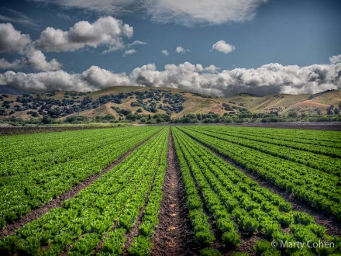
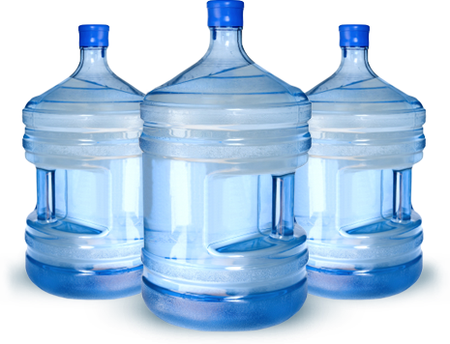
The Permit Balancing Act
Assure Safe Drinking Water
Preserve Agricultural Economy
“We must protect both …
… or we get neither”

Slide 5
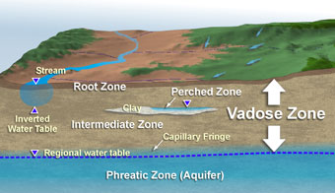
Traditional Nitrate Permitting Option
Nitrate must be < 10 mg/L…
Before reaching the groundwater basin

Slide 6
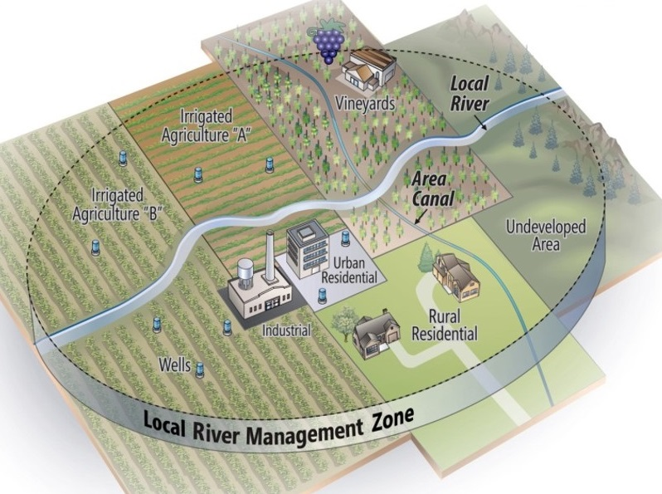
The New Management Zone Approach
Temporary exception from standards
Must assure safe drinking water first
Shared responsibility for implementation

Slide 7
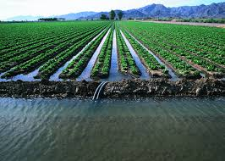
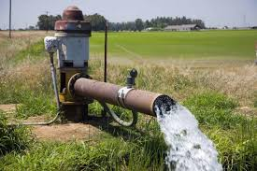
Management Zone versus SGMA
Into the ground
Out of the ground

Slide 8
Nitrate Priorities v. SGMA Priorities

Slide 9
Comparison between MZ and GSA
Management Zone
Groundwater Sustainability Agency
Regulatory Construct
Compliance Unit for N
Discharger Cooperative
Collective implementation for ensuring N impacted users have safe drinking water
Statutory Construct
Local management entity with legal authority
State intervention if necessary
Sustainable groundwater management in 20 years

Slide 10
Differences in Authorities
Management Zone
Groundwater Sustainability Agency
Regulatory alternative for dischargers that elect this path
Contractual agreement amongst dischargers
May be a local agency, but not necessary
Water Board ensures implementation through waste discharge requirements
Serves as alternative compliance for complying with nitrate water quality objective
State law requirement, or be subject to State Water Board
Adopt rules, regulations & ordinances
Conduct investigations
Require well registration, submission of annual statements, etc.
Regulate extractions
Impose fees

Slide 11
Content Requirements: Management Zone Implementation Plan & Groundwater Sustainability Plan
Management Zone Implementation Plan
Groundwater Sustainability Plan
Drinking water needs
Time to achieve balance & restoration
Community collaboration
Funding & Cost Share Agreements
Nitrate management activities
Water quality characterization
Short term (<20 years) & long term (>20 years) projects
Milestones
Schedule of implementation
Participant Responsibilities
Surveillance and Monitoring
Basin characteristics
Hydrogeologic conceptual model
Groundwater conditions
Water budget
Identification of management areas (if applicable)
Sustainability goal (i.e., sustainable yield)
Identification of undesirable results
Minimum thresholds
Measurable Objectives/Milestones
Monitoring Network
Projects & Management Actions

Slide 12
GSP Water Quality Element
Degraded Water Quality
23 CCR §354.28(c)
“Minimum threshold for degraded water quality shall be the degradation of water quality, … as determined by the Agency that may lead to undesirable results. … In setting minimum thresholds for degraded water quality, the Agency shall consider local, state, and federal water quality standards applicable to the basin.”

Slide 13
Key Commonalities
Groundwater
Ground zero for
over-draft and nitrates
Similar implementation actions
Same folks paying for both

Slide 14
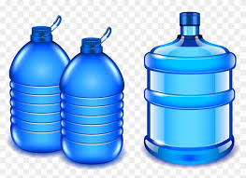
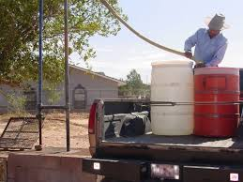
Enforcement Actions
Salinas Basin Agreement
Kaweah Agreement

Slide 15
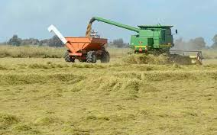
“Water is the driving force of all nature.” Leonardo de Vinci
Contact Information
Tess Dunham
Somach Simmons & Dunn
tdunham@somachlaw.com
(916)-446-7979

