Slide 1
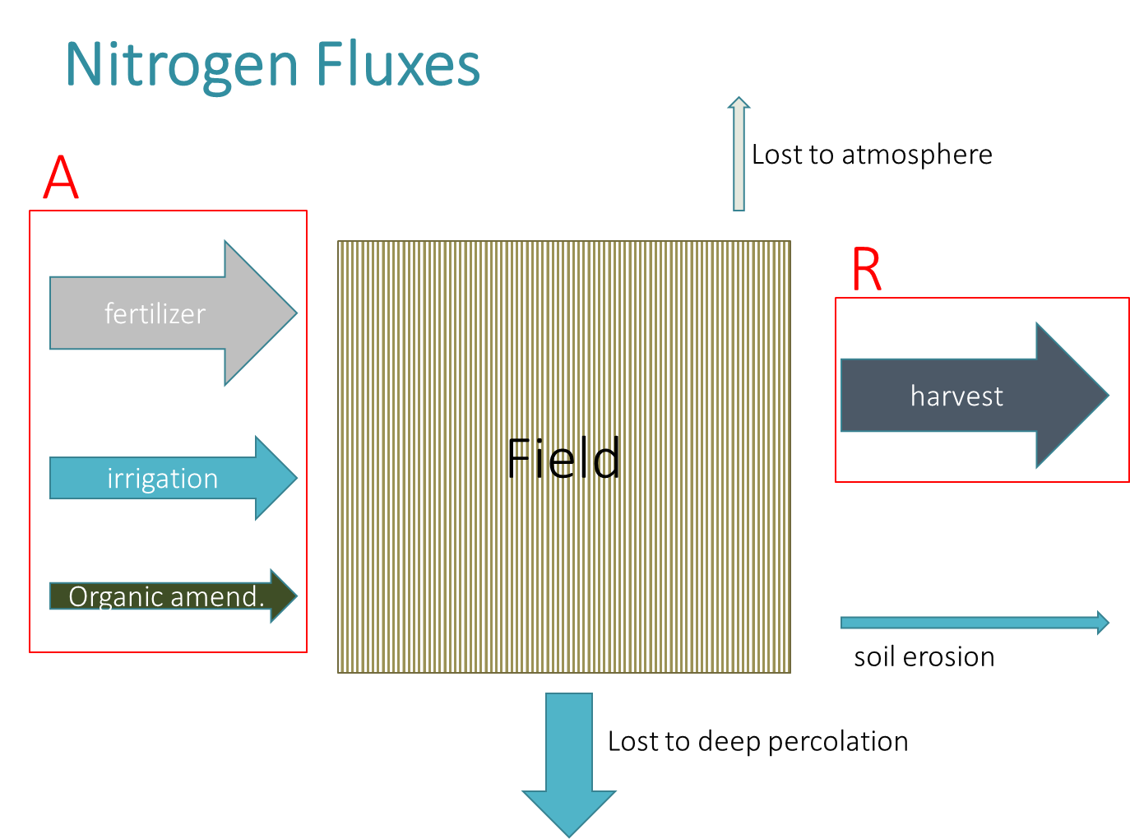
Regulatory Tools for Addressing Nitrates in Groundwater
Emel G. Wadhwani
Assistant Chief Counsel
State Water Resources Control Board

Slide 2
Regulatory Tools Overview
Basin Planning
1
Policy Adoption
2
Permitting
3
Petition Review
4
Enforcement
5

Slide 3
Basin Planning
Beneficial Uses
Examples: Water Contact Recreation (REC1); Warm Freshwater Habitat (WARM)
Municipal and Domestic Supply (MUN)
Objectives
Examples:
Waters shall not contain oils, greases, waxes, or other materials in concentrations that result in a visible film or coating on the surface of the water . . .
Groundwater designated as MUN shall not contain contaminants in concentrations in excess of specified Maximum Contaminant Levels (MCLs) – Nitrate + Nitrite (as N) 10 mg/l

Slide 4
Basin Planning
CV-SALTS
(Central Valley Salinity Alternatives for Long-term Sustainability)
Basin Plan amendment
Adopted by the Central Valley Water Board and pending before the State Water Board

Slide 5
Policies
Antidegradation Policy (1968)
Nonpoint Source Policy (2004)

Slide 6
Antidegradation
Antidegradation
High Quality Water
Requires justification through findings consistent with the antidegradation policy
Maximum benefit
BPTC
Water at Objectives
Prohibited
Association De Gente Unida Por El Agua v. Central Valley Regional Water Quality Control Board (2012) 210 Cal.App.4th 1255

Slide 7
Nonpoint Source Policy
Monitoring and Reporting
Implementation of Management Practices
Water Quality Outcomes
Improved Management Practices

Slide 8
Nonpoint Source Policy
“. . . the NPS Policy expressly requires time schedules and quantifiable milestones; the purpose is to assure that the water quality objectives are eventually met. But there is no requirement that the ultimate goal of preventing and cleaning up NPS pollution be accomplished within the lifespan of the modified waiver. . . .Without specific time schedules and quantifiable milestones, there is not a ‘high likelihood’ the program will succeed in achieving its objectives, as required by NPS Policy.”
Monterey Coastkeeper v. State Water Resources Control Board (2018) 28 Cal.App.5th 342.

Slide 9
Nonpoint Source Policy
Monitoring and Reporting
Implementation of Management Practices
Water Quality Outcomes
Milestone
Milestone
Milestone
Meet Objectives
Improved Management Practices

Slide 10
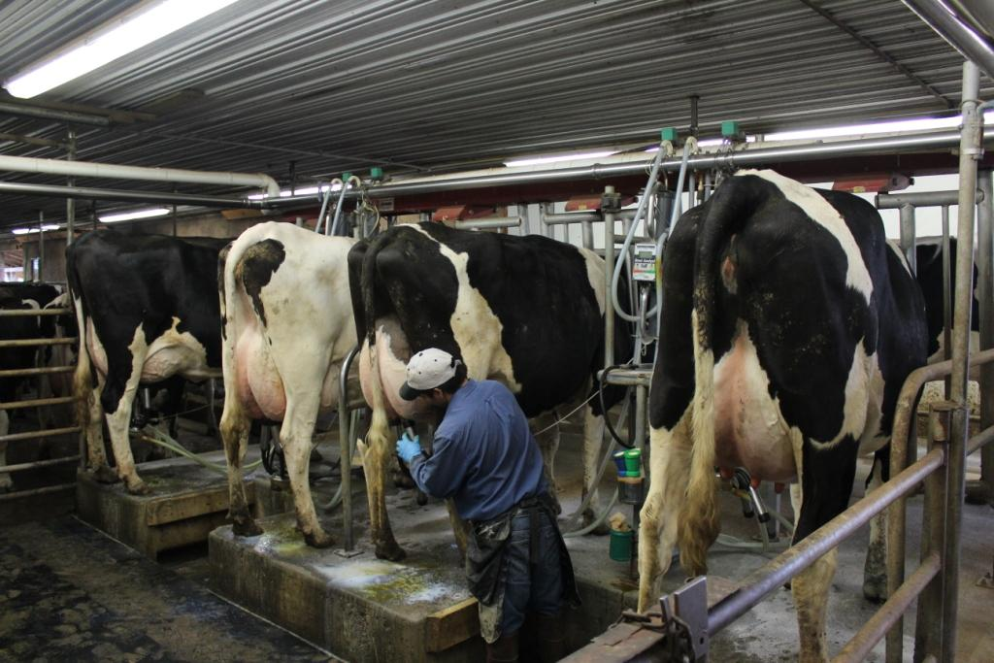
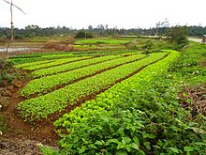
Permitting
Receiving Water Limitations
Discharges may not cause or contribute to exceedances of water quality objectives
Immediate compliance or time schedule
Antidegradation findings
Requirements for Management Practice Implementation
Nutrient management plans
Monitoring and Reporting Requirements
Groundwater monitoring
Drinking water well sampling
Coalition-based vs. direct regulation

Slide 11
Petitions
State Water Board Order
WQ 2018-0002
Reviewed Central Valley Water Board’s Agricultural Waste Discharge Requirements for the Eastern San Joaquin Watershed
Incorporated recommendations of
Nitrogen Tracking Task Force Report (CDFA, 2013)
Agricultural Expert Panel Report (State Water Bd, 2014)
Established statewide precedential requirements for nitrogen tracking and reporting

Slide 12
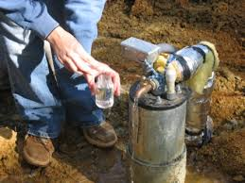
On-Farm Drinking Water Well Sampling
Sampling for nitrates
Notification to users

Slide 13
Nitrogen Management
Tracking applied nitrogen (A) and removed nitrogen (R) – A/R and A-R; multi-year values
A: Nitrogen applied to the field in fertilizer, organic amendments, and irrigation water
R: Nitrogen removed from field in harvested or other materials or as sequestered in permanent crops

Slide 14
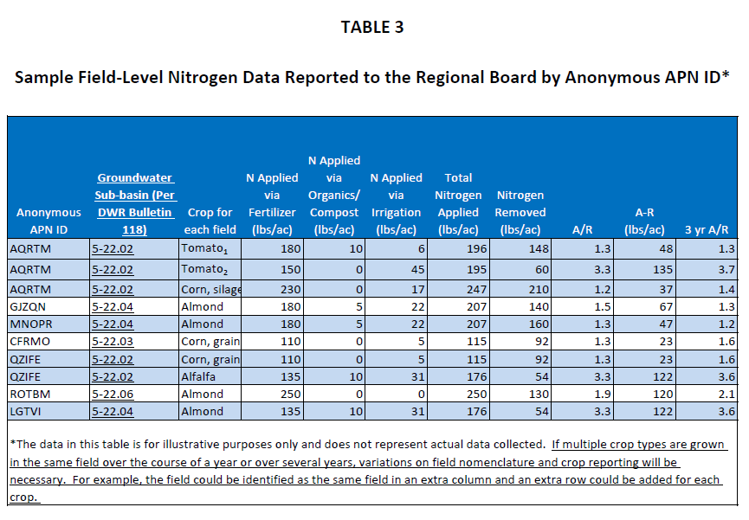

Slide 15
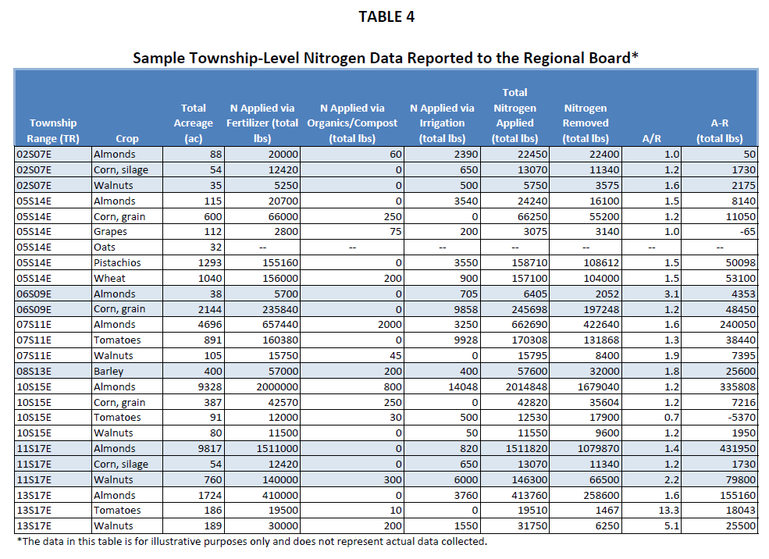

Slide 16
Use of AR Data by Regional Boards
Verify that appropriate follow up is conducted and responsive management practices are implemented
Approve groundwater protection targets for nitrogen loading within a township
Evaluate field-level data for development of acceptable ranges for multi-year A/R ratio target values

Slide 17
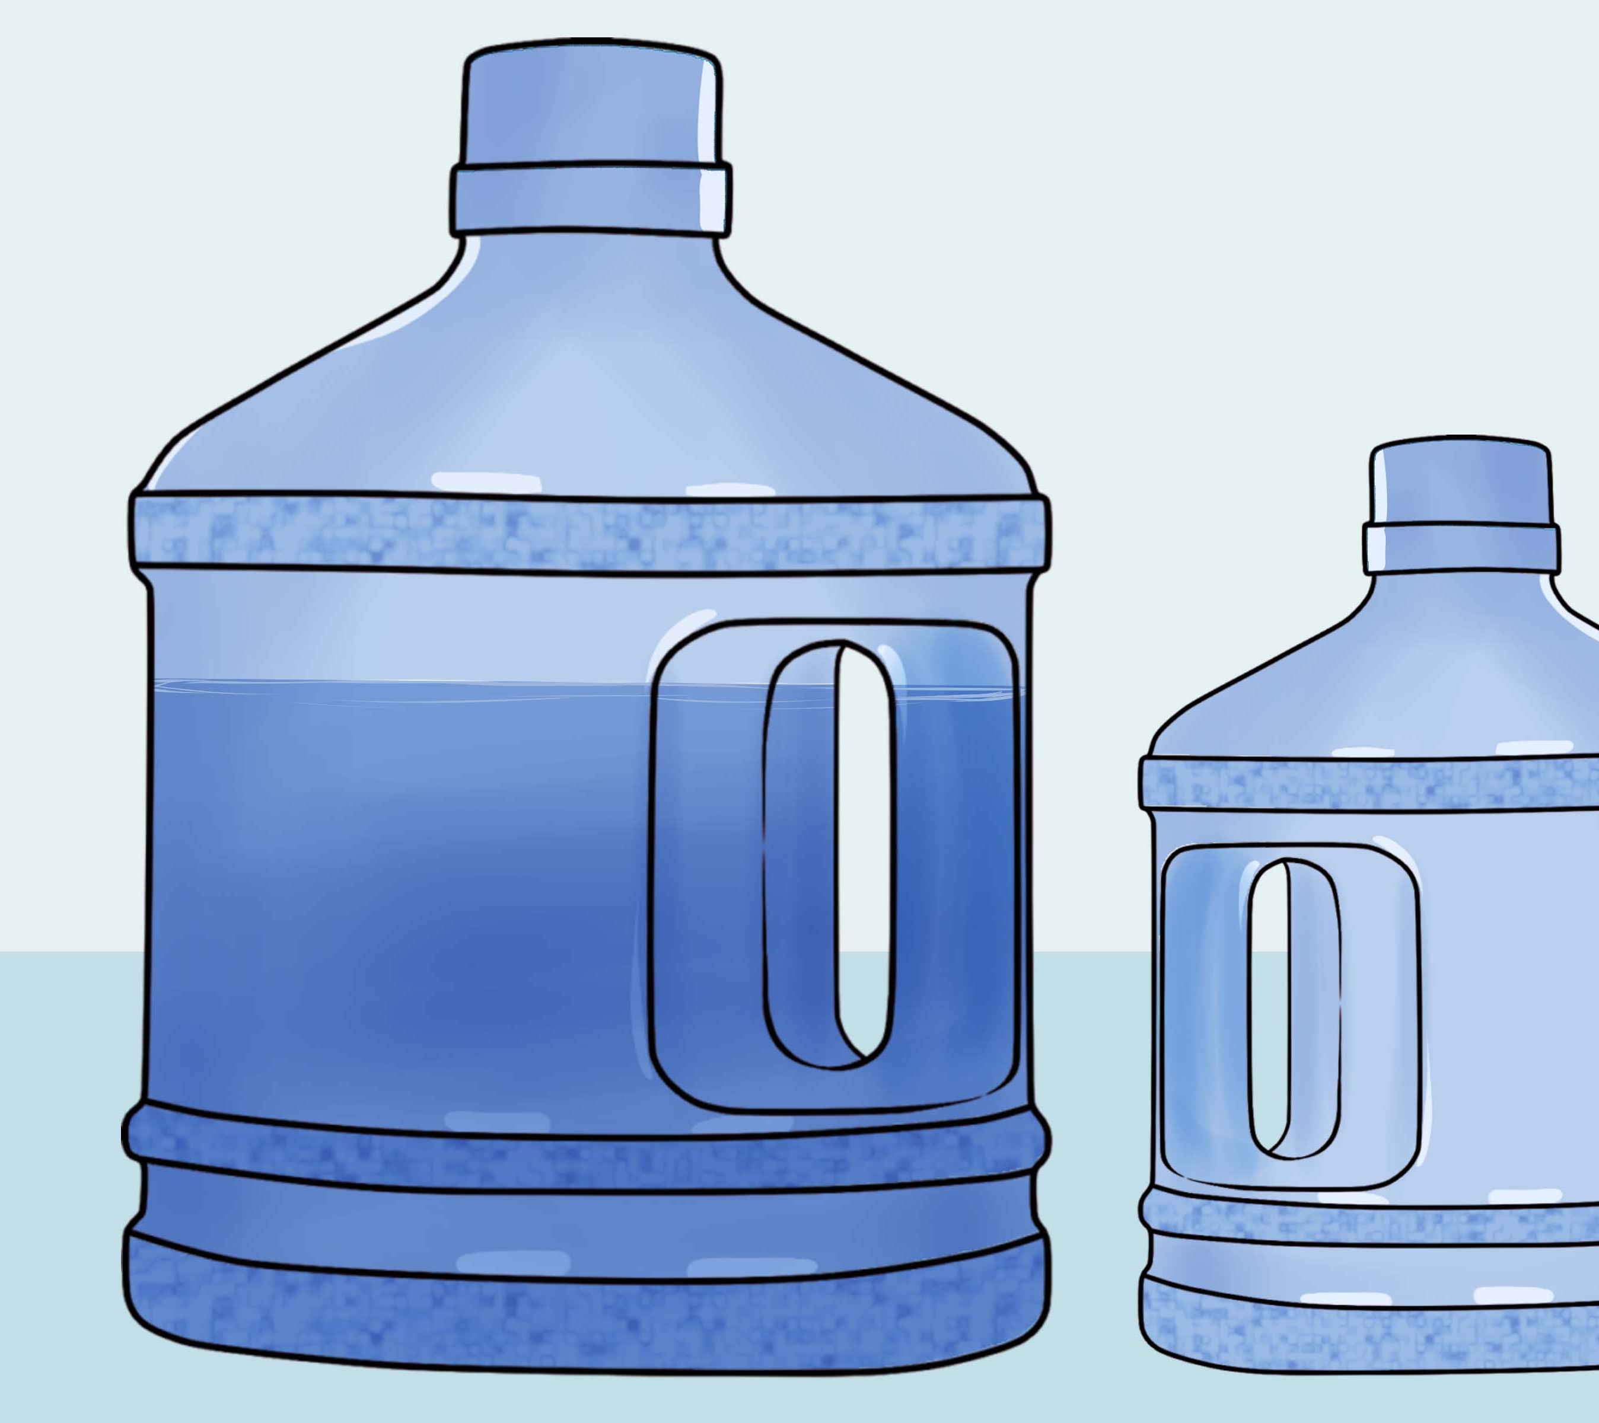
Enforcement
Settlements for replacement drinking water
Salinas Basin Agricultural Stewardship Group (2017)
Kaweah Basin, Tulare Basin, and Kings River Watershed Coalitions (2019)

Slide 18
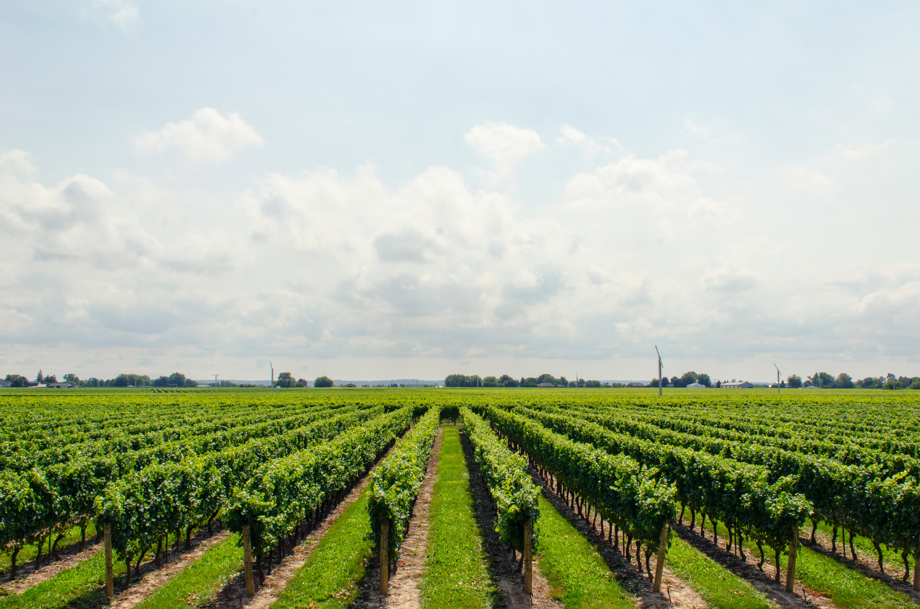
Permitting (upcoming)
Several regions adopting or renewing agricultural orders (North Coast, Colorado River)
Central Valley Water Board actions to update all permits consistent with the Eastern San Joaquin Order
Central Coast Water Board proceedings to adopt “Ag Order 4.0”

Slide 19
End

