Slide 1
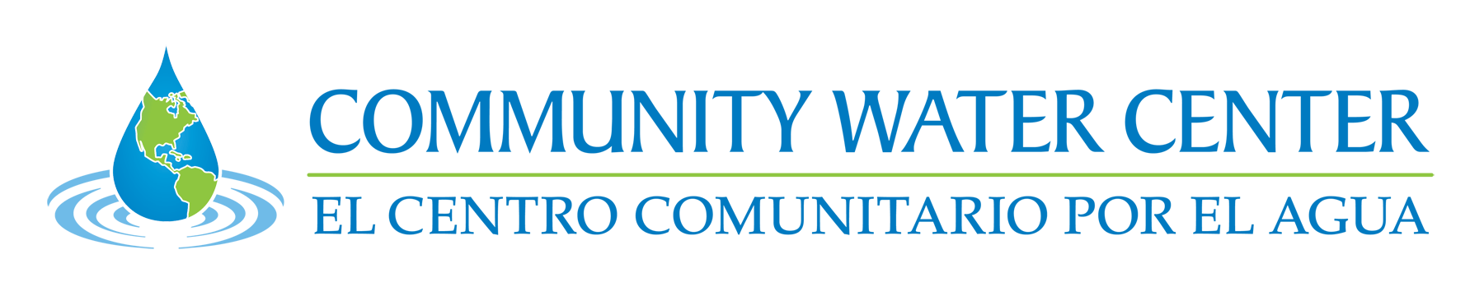
Nitrates and the Human right to water
Debi Ores, Staff Attorney
Water Law Symposium
www.communitywatercenter.org

Slide 2
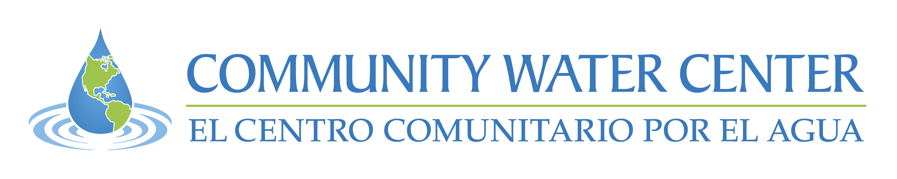
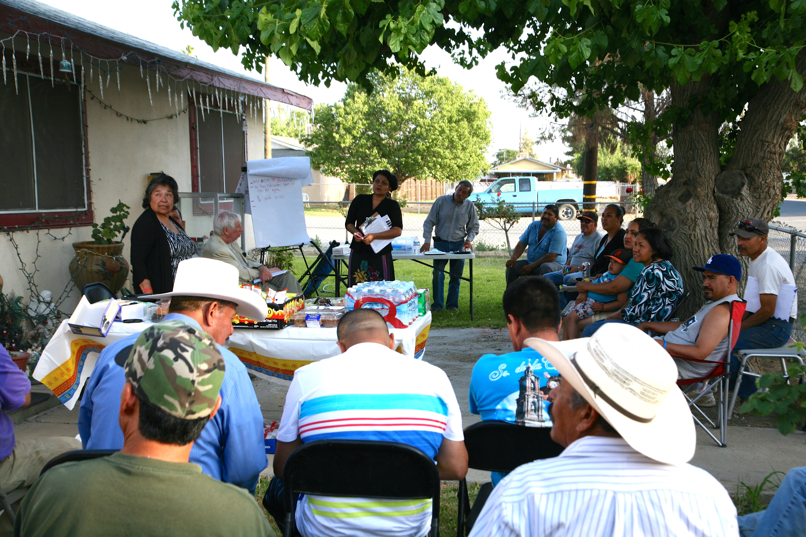
Advancing community-driven water solutions through organizing, education, and advocacy

Slide 3
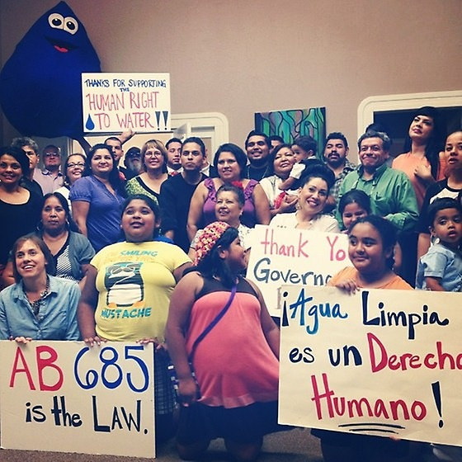
Human Right to Water
In 2012 California was the first state in the nation to recognize the human right to water.
“Every human being has the right to safe, clean, affordable, and accessible water adequate for human consumption, cooking, and sanitary purposes.” – Water Code 106.3
State Water Board and many of the Regional Water Boards have also passed Resolutions on the Human Right to Water

Slide 4
San Joaquin Valley
95% of residents rely upon groundwater for source of drinking water
23% of water systems in Valley are out of compliance with one or more drinking water standards
350,000 people live within disadvantaged (DAC) or severely disadvantaged communities (SDAC)
66% of water systems serving DACs that are out of compliance are situated within a mile of a nearby system
Notes:
Define DAC & SDAC
Define PWS, SSWS
Mention regs

Slide 5

Drinking water in DACs
Most DACs are served by PWSs, however, many of these systems are small and lack economies of scale to address issues with supply
Other DACs are served by State Small Water Systems or private wells – no testing requirements
Private wells are typically shallower and thus more susceptible to contamination – especially nitrates

Slide 6
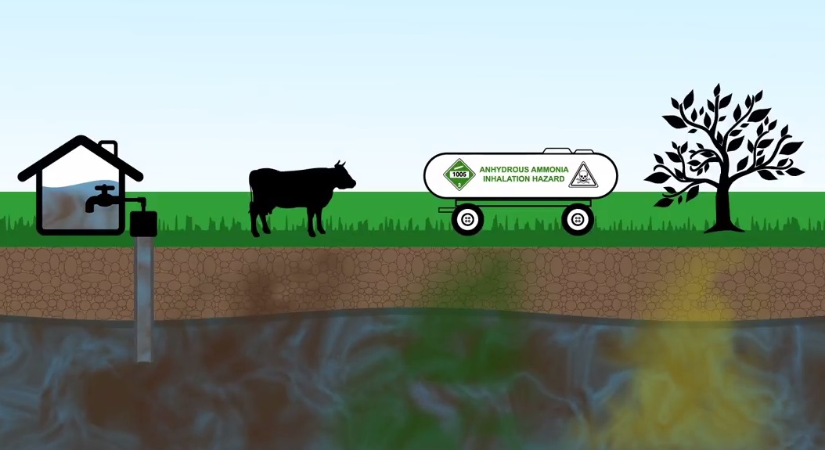
Sources of nitrates in groundwater
MCL: 10 mg/L (measured as nitrogen), 45 mg/L (measured as nitrate)
Predominantly from fertilizers and animal manure
Small percentages in localized areas from leaky septic systems
Very low background levels

Slide 7
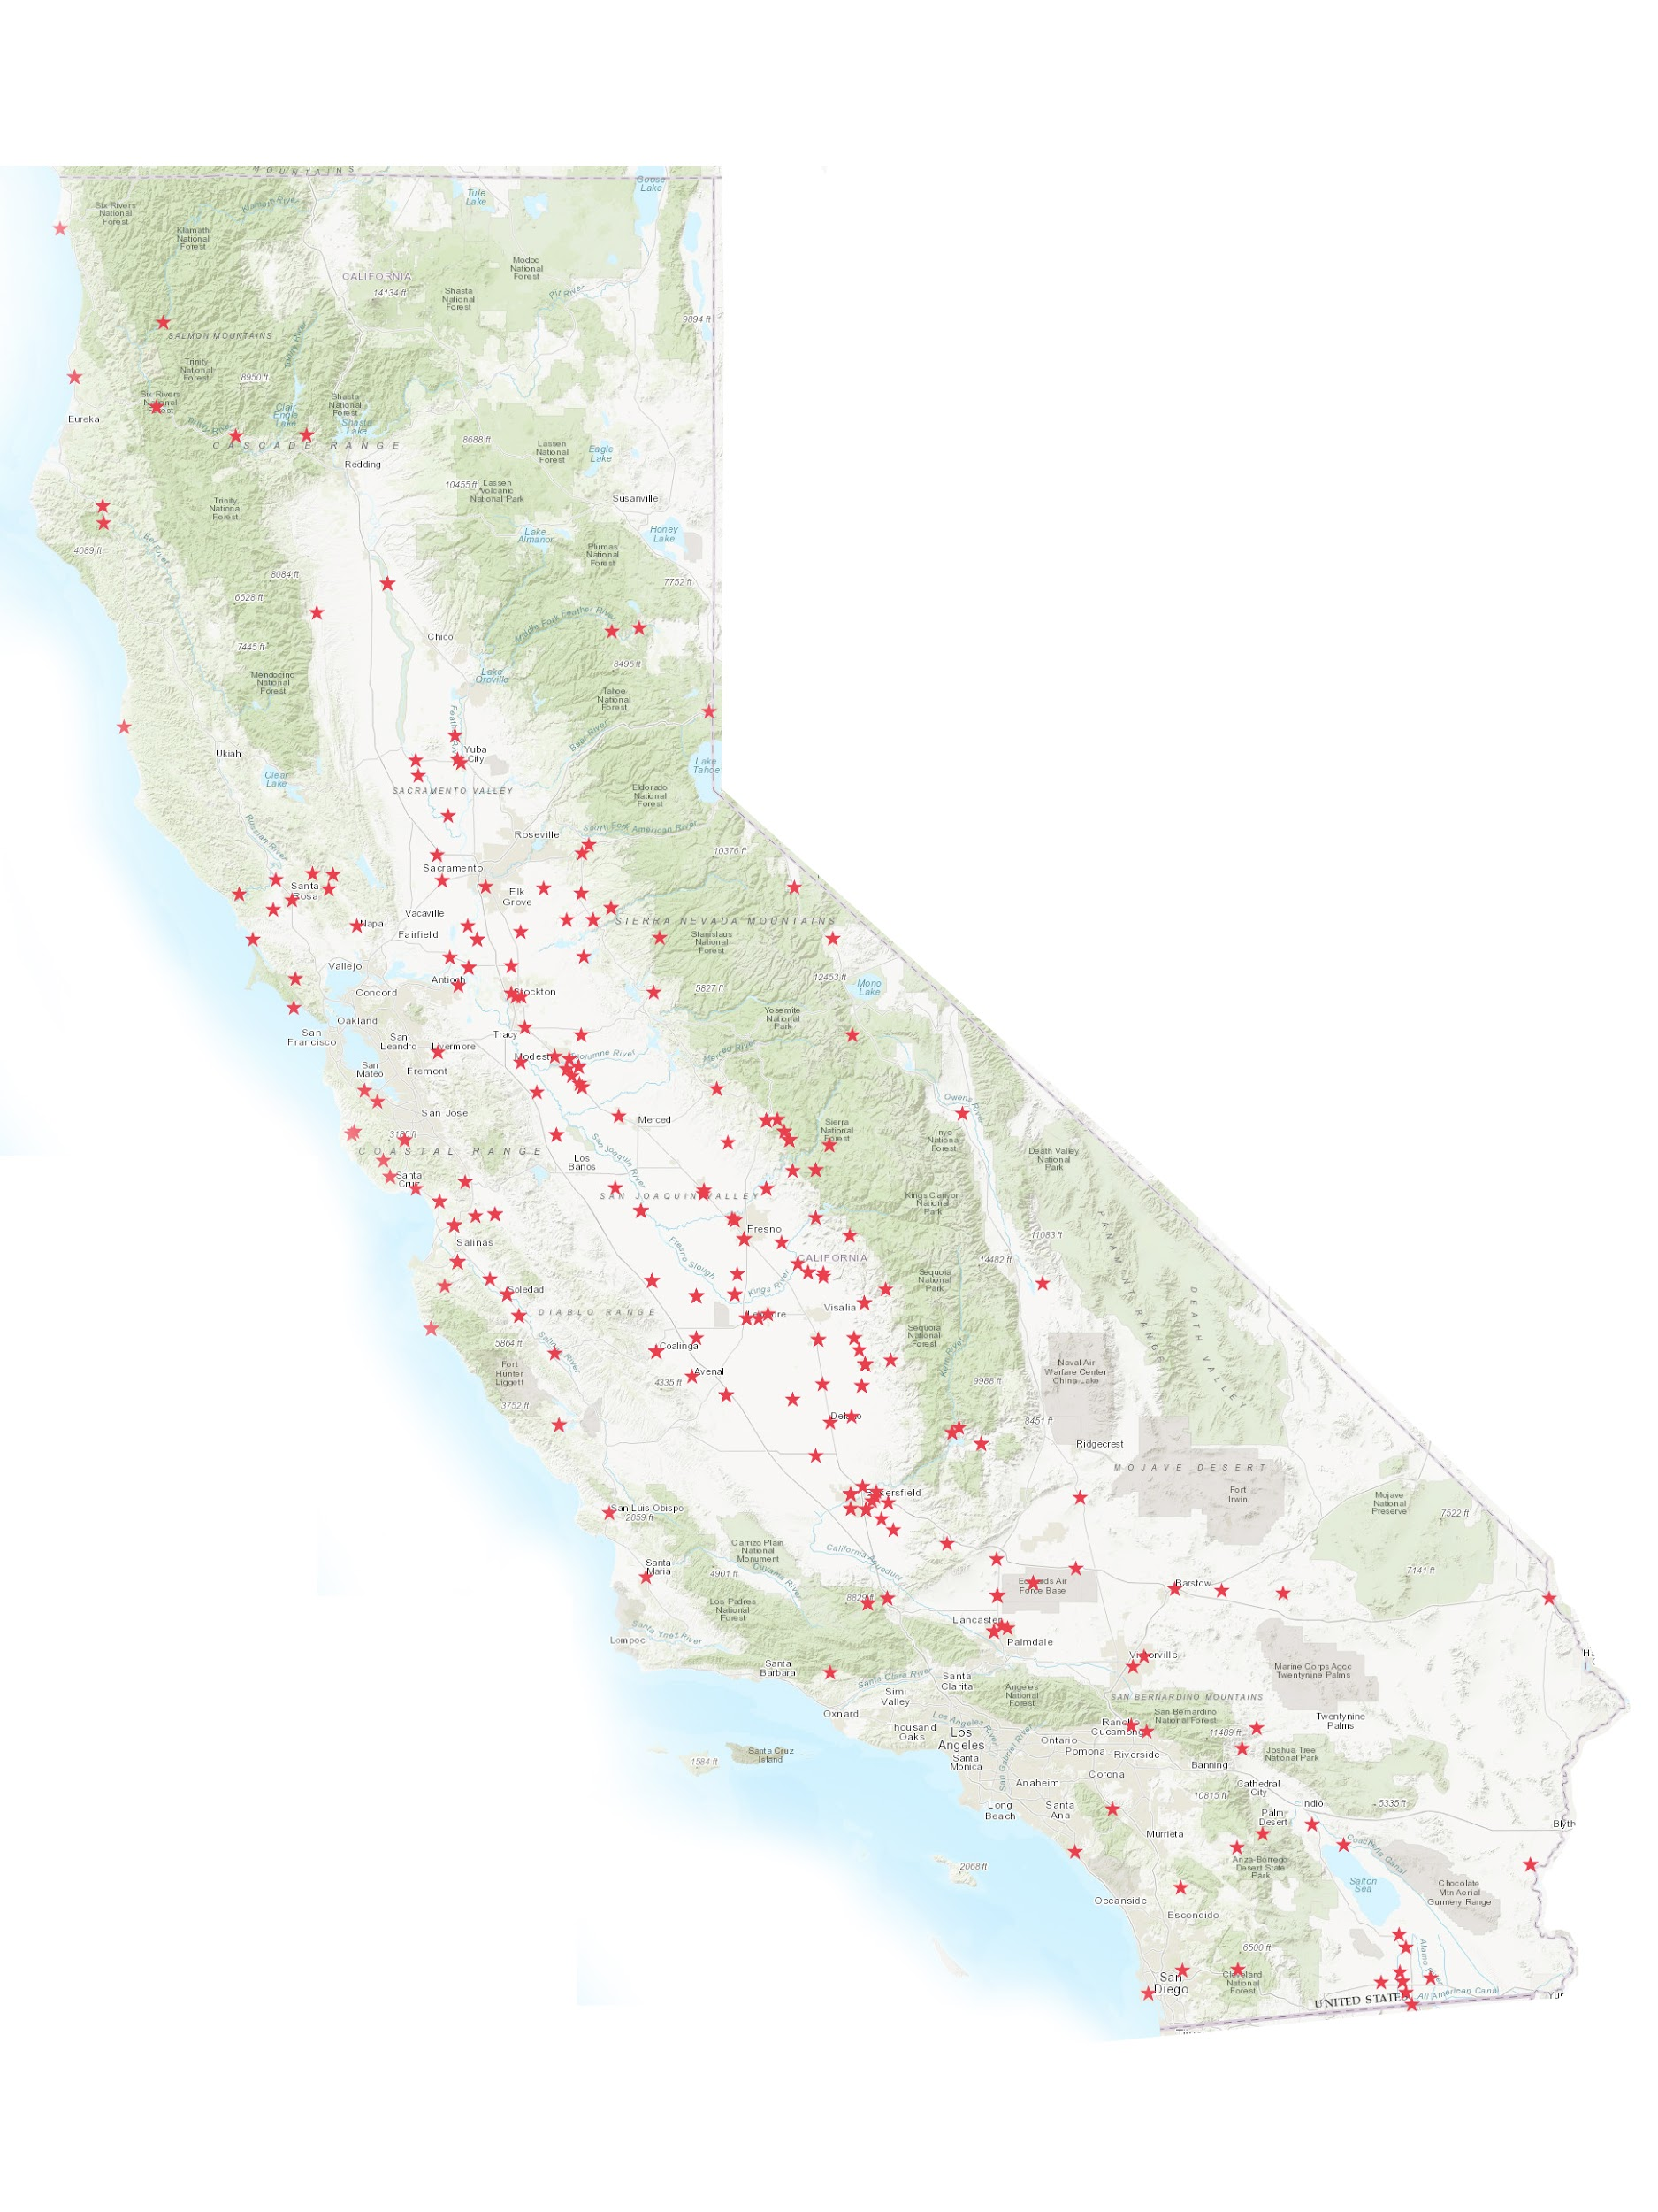
Nitrates and Drinking water
USGS nitrate studies: 40% of domestic wells in Tulare Lake Basin exceed nitrates standard (2006, 2012)
UC Davis Nitrates report: over a quarter million impacted by nitrate contamination (2012)
Central Coast Irrigated Lands Program: 40% of domestic wells tested in Salinas Valley exceed the nitrate standard (2012-present)

Slide 8
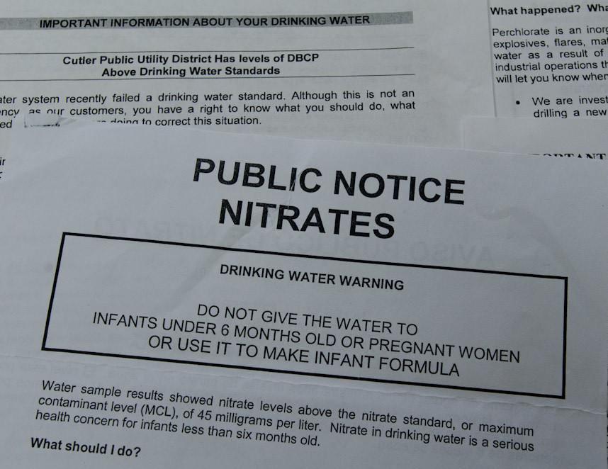
Health Impacts of Nitrates
Methemoglobinemia “Blue baby syndrome”
Reproductive harm
Chances of:
  Cancer
  Thyroid issues
  Fatigue

Slide 9
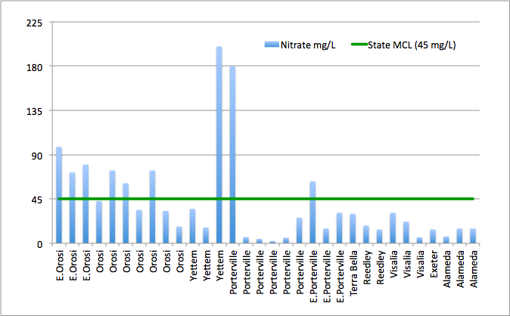
CWC Private Well Testing – Nitrate Results
Notes:
Testing costs

Slide 10
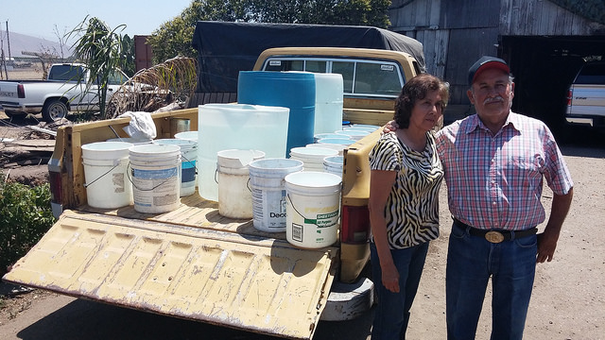
Solutions for impacted communities
Prevent contamination in the first place
Replacement water, ie bottled water, only for emergency service
Point-of-use or point-of-entry systems
Consolidation/service extensions
Alternative source of water
System-level treatment
Adequate funding

Slide 11
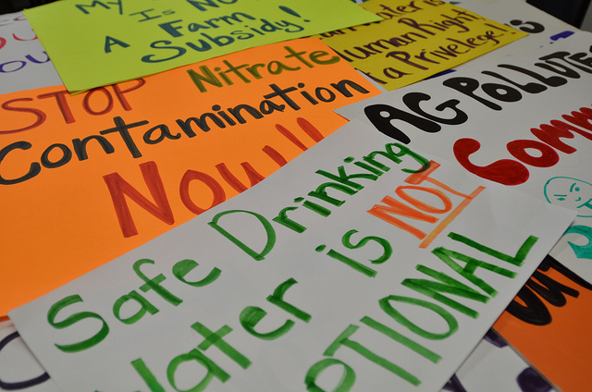
Preventing nitrate contamination
Irrigated Lands Regulatory Program (ILRP)
CV-SALTS
CAFO Orders – most notably the Dairy General Order
  AGUA v Central Valley Regional Water Quality Board 210 Cal.App.4th 1255 (2012)

Slide 12
Lack of adequate funding to address drinking water issues

Slide 13
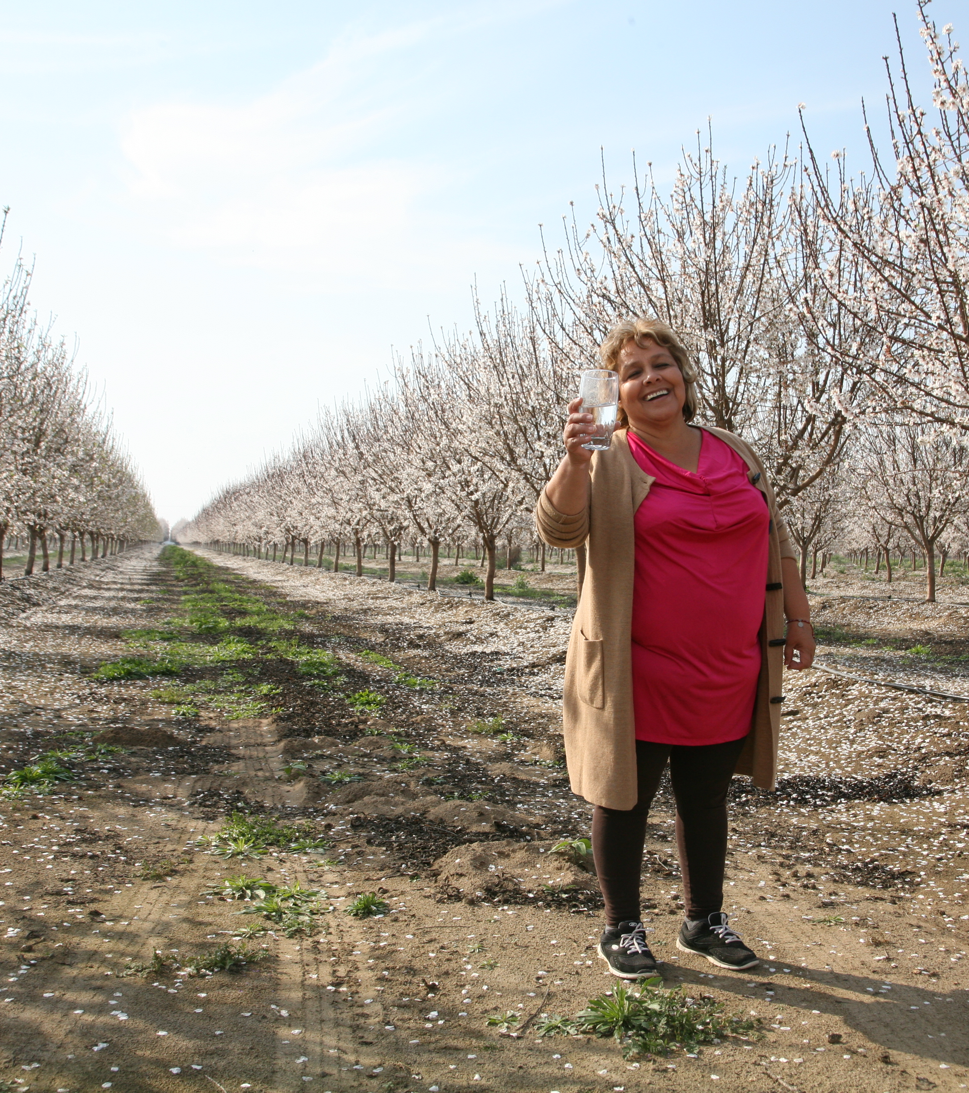

Community Water Center: Because clean water is a right, not a privilege.
Join the movement and find out more online!
CommunityWaterCenter.org
Deborah.Ores@
CommunityWaterCenter.org

