Slide 1
SUSTAINABLE GROUNDWATER MANAGEMENT ACT (SGMA)---2014
Provides for sustainable management of groundwater basins
Enhances local management of groundwater consistent with rights to use
Minimum standards for effective, continuous management of groundwater
Minimizes impact for land subsidence
Improves data collection and understanding of groundwater resources
Empowers local agencies to manage groundwater basins while minimizing state intervention

Slide 2
Sustainable Groundwater Management Act (2014)
1. Requires State Department of Water Resources to
designate groundwater basin boundaries and designate those basins which are “high” or “medium” priority
2. These basins must be managed by a local “Groundwater Sustainability Agency” by January 1, 2020 if in critical “overdraft” condition
3. The Agencies responsible for “Groundwater Sustainability Plans” must be formed for these basins by July 1, 2017

Slide 3
SGMA
California Water Code, Division 6, Part 2.74
Chapters 1-5, Sections 10720 through 10755.4

Slide 4
KEY DEFINITIONS IN SGMA
“SUSTAINABLE YIELD”---Maximum quantity of water calculated over long-term conditions in the basis, including any temporary excess that can be withdrawn over a year without an undesirable result
“SUSTAINABLE GROUNDWATER MANAGEMENT”—Management and use of groundwater that can be maintained without causing an undesirable result.
“UNDESIRABLE RESULT”---Persistent lowering of groundwater levels, significant reduction in groundwater storage, salt water intrusion, degradation of water quality, significant land subsidence, surface water depletion.

Slide 5
High and Medium Priority Basins
The following Maps show these basins as Determined by the State Department of Water Resources
See also, DWR Bulletin 118

Slide 6
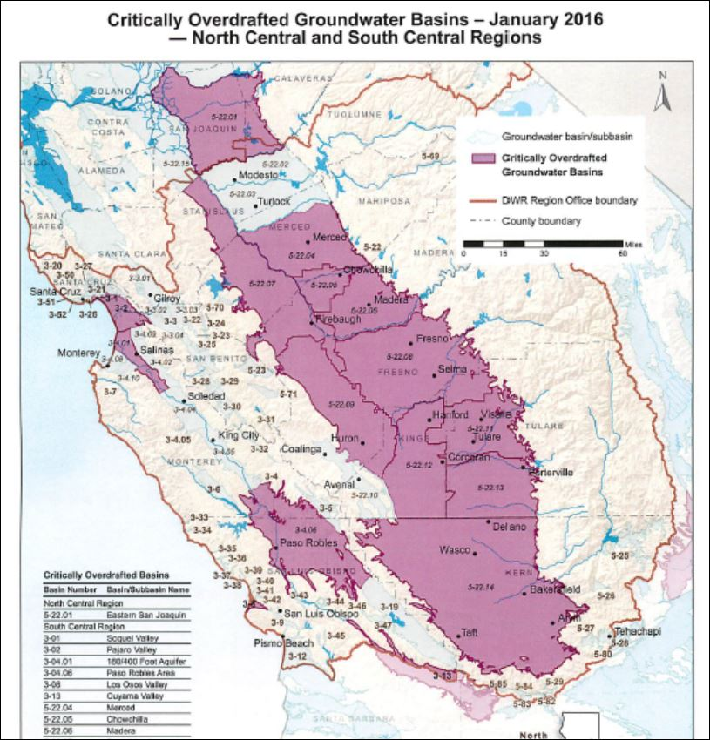

Slide 7
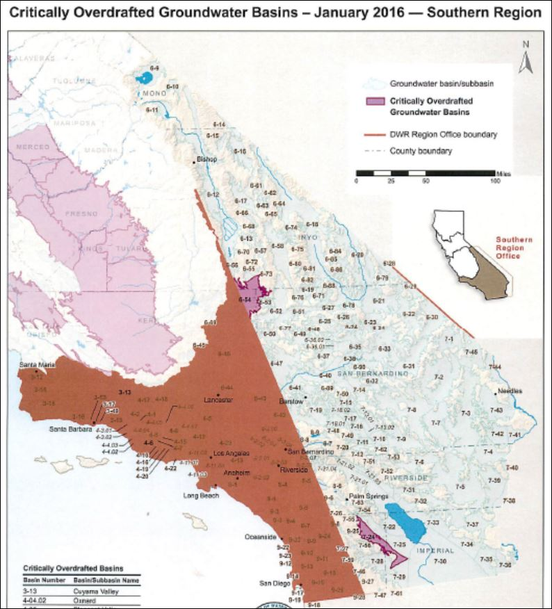

Slide 8
GROUNDWATER ADJUDICATION REFORM----SB 226, AB 1390 (2015)
AB 1390 codifies the rules for basin-wide groundwater adjudications
AB 1390 amends the Code of Civil Procedure
SB 226 adds a chapter to SGMA in the Water Code
Make adjudication process more cost effective
Ensure that the process is comprehensive and fair
Harmonize the process with SGMA

Slide 9
AB 1390---ADJUDICATION REFORM
Basin Boundaries are identified by DWR in Bulletin 118 and adjusted by DWR when justified
Selection of a Judge by Judicial Council for all purposes. Local Judges are disqualified and no preemptory challenges
Notice and Service to all parties including landowners, groundwater sustainability agencies, cities, counties, tribes and other state and federal entities.
Intervention---State and local agencies have the right to intervene in adjudication action

Slide 10
AB 1390 ADJUDICATION REFORM
Adjudication actions are presumed to be complex
Case Management Issues:
1. Divide the case into phases to resolve legal and factual issues.
2. Limitations on discovery during different phases
3. Adopt measures to avoid re-litigating issues
4. Schedule early resolution of issues such as prescriptive rights
5. Appointing a special master

Slide 11
AB 1390 ADJUDICATION REFORM
Initial Disclosures: Within 6 months of appearing in comprehensive adjudication, all parties all serve:
Quantity of any groundwater extracted from the basin by the party and the method of measurement for past 10 years
Type of water rights claimed for the extraction of groundwater
Description of the purpose to which groundwater is being used
Location of each well or other source of water
Claims for increased or future use of groundwater
Disclosures to be amended later if appropriate and made under penalty of perjury

Slide 12
EXPERT TESTIMONY
CCP 843—Parties required to submit expert reports which include a statement of all opinions expressed, the facts and data relied upon, the qualifications of the expert, the exhibits the expert will use at trial, etc.
Unless dates are ordered by the Court, the expert disclosures shall be made at least 30 days after the court’s entry of an order establishing the relevant phase of the adjudication

Slide 13
Groundwater Rights
No state permit system (No Administrative Agency)
In 2015 Legislature enacted procedures for adjudications but retained common law definition of groundwater rights

Slide 14
Types of Groundwater Rights
Overlying landowner (like riparian surface right)
Appropriator for use on lands not overlying the basin (Usually public agencies) (Similar to surface appropriative right)
Prescriptive Rights
City of Barstow v. Mojave Water Agency
(2000) 23 Cal.4th 1224

Slide 15
Recent Development
9th Circuit Rules Reserved Rights Extend to groundwater – Agua Caliente Band of Cahuilla Indians v. United States 849 F.3d 1262 (March 7, 2017)
Federal Reserved Rights are rights to water necessary for federal reservations- National Parks, etc., and Indian Reservations
Until Now always related to surface water

Slide 16
Key Concepts
1. Overdraft – More water pumped from a basin each year than being replenished naturally or artificially
2. Safe Yield – Amount of water that can be pumped annually on the long term without causing overdraft
3. Sustainability – Use of groundwater to meet current and future purposes without causing unacceptable consequences

Slide 17
Important Limitations on Rights
California Constitution, Article X, § 2
. . . That waste or unreasonable use or unreasonable method of use be prevented. . .
Right to water . . .shall not extend to waste or unreasonable use or unreasonable method of use or unreasonable method of diversion. . .
Reasonable and beneficial use

Slide 18
Water Trading and the Role of Allocations and Adjudications
Christina Babbitt, PhD
California Water Law Symposium
February 2, 2019

Slide 19
Methods for Establishing Groundwater Pumping Allocations
Pro Rata Allocation per Overlying Acre
Divides available groundwater resources between overlying landowner proportionate to property size.
Pro Rata Allocation per Irrigated Overlying Acre
Certifies all existing overlying groundwater use (e.g. Irrigated acres) and develops an allocation proportionate to land use.
Allocation Based Upon a Fraction of Historic Pumping
Allocations are determined by historic pumping. Grandfathers in existing pumpers and excludes those who have not developed rights.
Comprehensive Allocation Method (Recommended)
Establishes groundwater allocations based on a comprehensive consideration of CA groundwater law, preserving the relative priority of overlying, prescriptive, and appropriative users.

Slide 20
Christina Babbitt cbabbitt@edf.org
www.edf.org/sgma

Slide 21
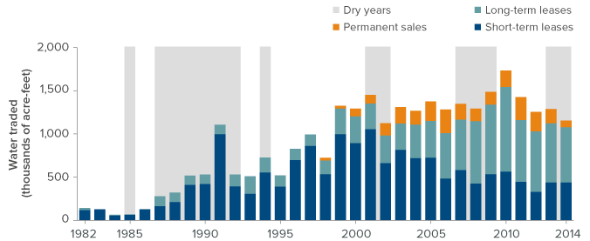
California’s Water Market
SOURCE: Updated from E. Hanak and E. Stryjewski. California’s Water Market, By the Numbers: Update 2012 (PPIC, 2012).
Notes:
Overall, California’s market now accounts for about 3% of all water used. Most trading occurs within the same county (38%) or region (41%).
NOTE: The figure shows water traded between entities that are not members of the same water district or wholesale agency. It excludes volumes committed under long-term lease and permanent-sale contracts that were not physically transferred because of hydrologic conditions or other factors (in 2014, roughly 800,000 acre-feet). Dry years are those classified as critical or dry for the Sacramento Valley.

Slide 22
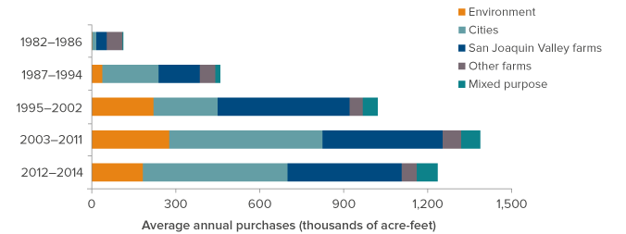
Cities, farms, and the environment acquire water through the market
SOURCE: Updated from E. Hanak and E. Stryjewski. California’s Water Market, By the Numbers: Update 2012 (PPIC, 2012).
Notes:
NOTES: The figure shows actual volumes purchased by different sectors. “Mixed purpose” denotes purchases by agencies with significant urban and agricultural uses, such as the Coachella Valley Water District and the San Luis Delta Mendota Water Authority.

